Slide 1
Annual Report 2024

Slide 4
Citation
Suggested citation: Burnet Institute and Kirby Institute. Australia’s progress towards hepatitis C elimination: annual report 2024. Melbourne: Burnet Institute; 2024
ISBN: 978-0-646-70456-2
DOI: https://doi.org/10.26190/unsworks/30597
Download full report here: https://burnet.edu.au/aushepC

Slide 5
Prepared by: Anna Wilkinson Samara Griffin
Editors:
Margaret Hellard | Joseph Doyle
Mark Stoové | Alexander Thompson
Gregory Dore | Behzad Hajarizadeh
Jason Grebely | Timothy Broady
Alisa Pedrana | Troy Combo

Slide 6
Data Contributors (in order of data presented)
Australian Collaboration for Coordinated Enhanced Sentinel Surveillance of Sexually Transmissible Infections and Blood Borne Viruses: Margaret Hellard, Mark Stoové, Jason Asselin, Michael Traeger, Victoria Polkinghorne, Nyssa Watson, Thi Nguyen, Long Nguyen, Carol El‑Hayek, and Samara Griffin (Burnet Institute); Rebecca Guy, Basil Donovan, Allison Carter, and Htein Linn Aung (Kirby Institute); Wayne Dimech (NRL Quality).
MIXMAX Melbourne Cohort hepatitis C sub‑study: Phoebe Hadley, Tarnia Fisher, Peter Higgs, Phyo Aung, Mark Stoové, Paul Dietze, and Rachel Sacks‑Davis (Burnet Institute); MIXMAX Melbourne Cohort Investigators.
ATLAS Indigenous Primary Care Surveillance and Research Network: James Ward, Parham Kebria, Alan Ho, Shellee Williams, and Rani West (University of Queensland Poche Centre for Indigenous Health); ATLAS network governance and investigator groups and participating Aboriginal Community Controlled Health Services.
Australian Needle Syringe Program Survey: Sue Heard, Farzaneh Zolala, Bradley Mathers, Jenny Iversen, and Lisa Maher (Kirby Institute).

Slide 7
Data Contributors (cont.)
National Prisons Hepatitis Network: Yumi Sheehan, Andrew Lloyd, and Behzad Hajarizadeh (Kirby Institute); Alexander Thompson (St Vincent’s Hospital Melbourne); Rebecca Winter and Mark Stoove (Burnet Institute).
Australian Hepatitis and Risk Survey in Prisons: Rugiatu Bah, Yumi Sheehan, Xiaoying Li, Gregory Dore, Jason Grebely, Andrew Lloyd, and Behzad Hajarizadeh (Kirby Institute).
Monitoring hepatitis C treatment uptake in Australia: Joanne Carson, Behzad Hajarizadeh, and Gregory Dore (Kirby Institute).
National Retreatment Project: Joanne Carson, Gail Matthews, Gregory Dore, and Behzad Hajarizadeh (Kirby Institute); Sebastiano Barbieri (Centre for Big Data Research in Health, University of New South Wales).
National hepatitis C diagnosis and care cascade: Jisoo Amy Kwon, Gregory Dore, Behzad Hajarizadeh, Maryam Alavi, Heather Valerio, Jason Grebely, Rebecca Guy, Richard Gray, Jenny Iversen, Lisa Maher, Jonathan King, and Skye McGregor (Kirby Institute); members of the Australian HCV Diagnosis and Care Cascade Reference Group.

Slide 8
Data Contributors (cont.)
Australia and New Zealand Liver and Intestinal Transplant Registry: Michael Fink and Wing‑Yee Lo (Victorian Liver Transplant Unit, Austin Health); Simone Strasser (Australian National Liver Transplant Unit, Royal Prince Alfred Hospital); Peter Hodgkinson (Queensland Liver Transplant Service, Princess Alexandra Hospital); John Chen (South Australian Liver Transplant Unit, Flinders Medical Centre); Robert Jones (Victorian Liver Transplant Unit, Austin Health); Bryon Jaques (Western Australian Liver Transplantation Service, Sir Charles Gairdner Hospital).
Stigma Indicators Monitoring Project: Timothy Broady, Loren Brener, Elena Cama, and Carla Treloar (Centre for Social Research in Health, University of New South Wales).
Needle Syringe Program National Minimum Data Collection: Sue Heard, Bradley Mathers, Jenny Iversen, and Lisa Maher (Kirby Institute).
Gay Community Periodic Survey: Timothy Broady, James MacGibbon, Anthony Smith, Limin Mao, and Martin Holt (Centre for Social Research in Health, University of New South Wales); Benjamin Bavinton and Curtis Chan (Kirby Institute).

Slide 9
Data Contributors (cont.)
Viral Hepatitis Mapping Project: Jennifer MacLachlan and Benjamin Cowie (Peter Doherty Institute for Infection and Immunity).
Mathematical modelling: Jisoo Amy Kwon, Gregory Dore, Jason Grebely, Behzad Hajarizadeh, Rebecca Guy, and Richard Gray (Kirby Institute); Chris Estes and Homie Razavi (Centre for Disease Analysis).
Mathematical modelling: Chris Bailie, Joseph Doyle, Margaret Hellard, and Nick Scott (Burnet Institute).

Slide 10
Chapter One
Newly acquired hepatitis C infections

Slide 11
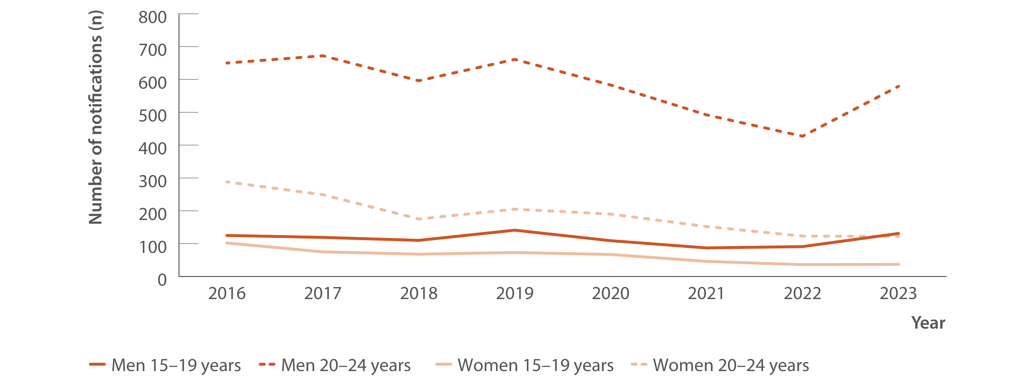
Figure 1. Number of hepatitis C (unspecified and newly acquired) notifications by age group and gender, 2016–2023
New infections
Source: Australian National Notifiable Diseases Surveillance System.(4,9)
Notes:
Source: Australian National Notifiable Diseases Surveillance System.^{(4,9)}
Notes: Cases other than newly acquired were assigned as unspecified.

Slide 12
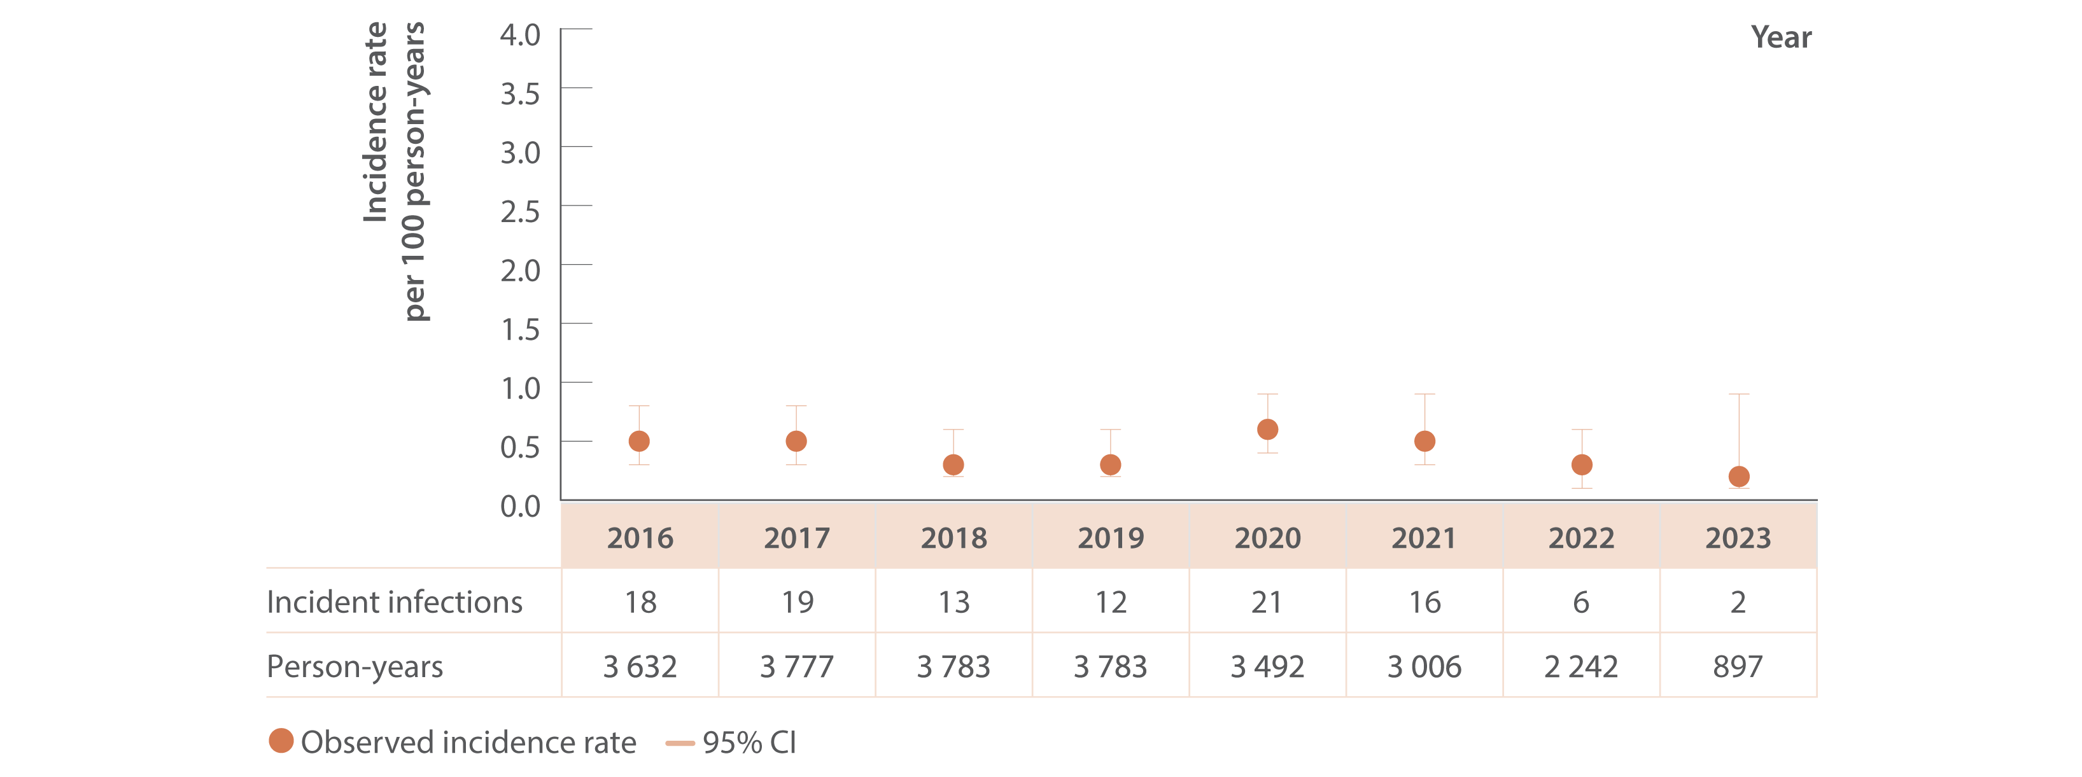
Figure 2. Incidence of primary hepatitis C infection among individuals tested at ACCESS primary care clinics, ACCESS, 2016–2023
New infections
Source: ACCESS.(11)
Notes:
Notes: Analysis includes N=11 427 individuals and 30 181 tests (2009–2023) with data from 2016 shown for brevity. Analysis includes 16 sites: 14 in Victoria (VIC), one in Western Australia (WA), and one in Queensland (QLD). Primary care clinics see high caseloads of people at risk of hepatitis C and provide both specialist services to current or former people who inject drugs as well as general health services. First incident infection only included in analysis. Incident infection date was assigned as the midpoint between the positive HCV antibody or HCV RNA test date and previous HCV antibody negative test date. ACCESS collates data from January 2009. Individuals included tested HCV antibody negative on their first test observed and had at least one follow‑up test (HCV antibody or HCV RNA or both) on or before 31 December 2023. Individuals were 15 years or older. CI: confidence interval.

Slide 13
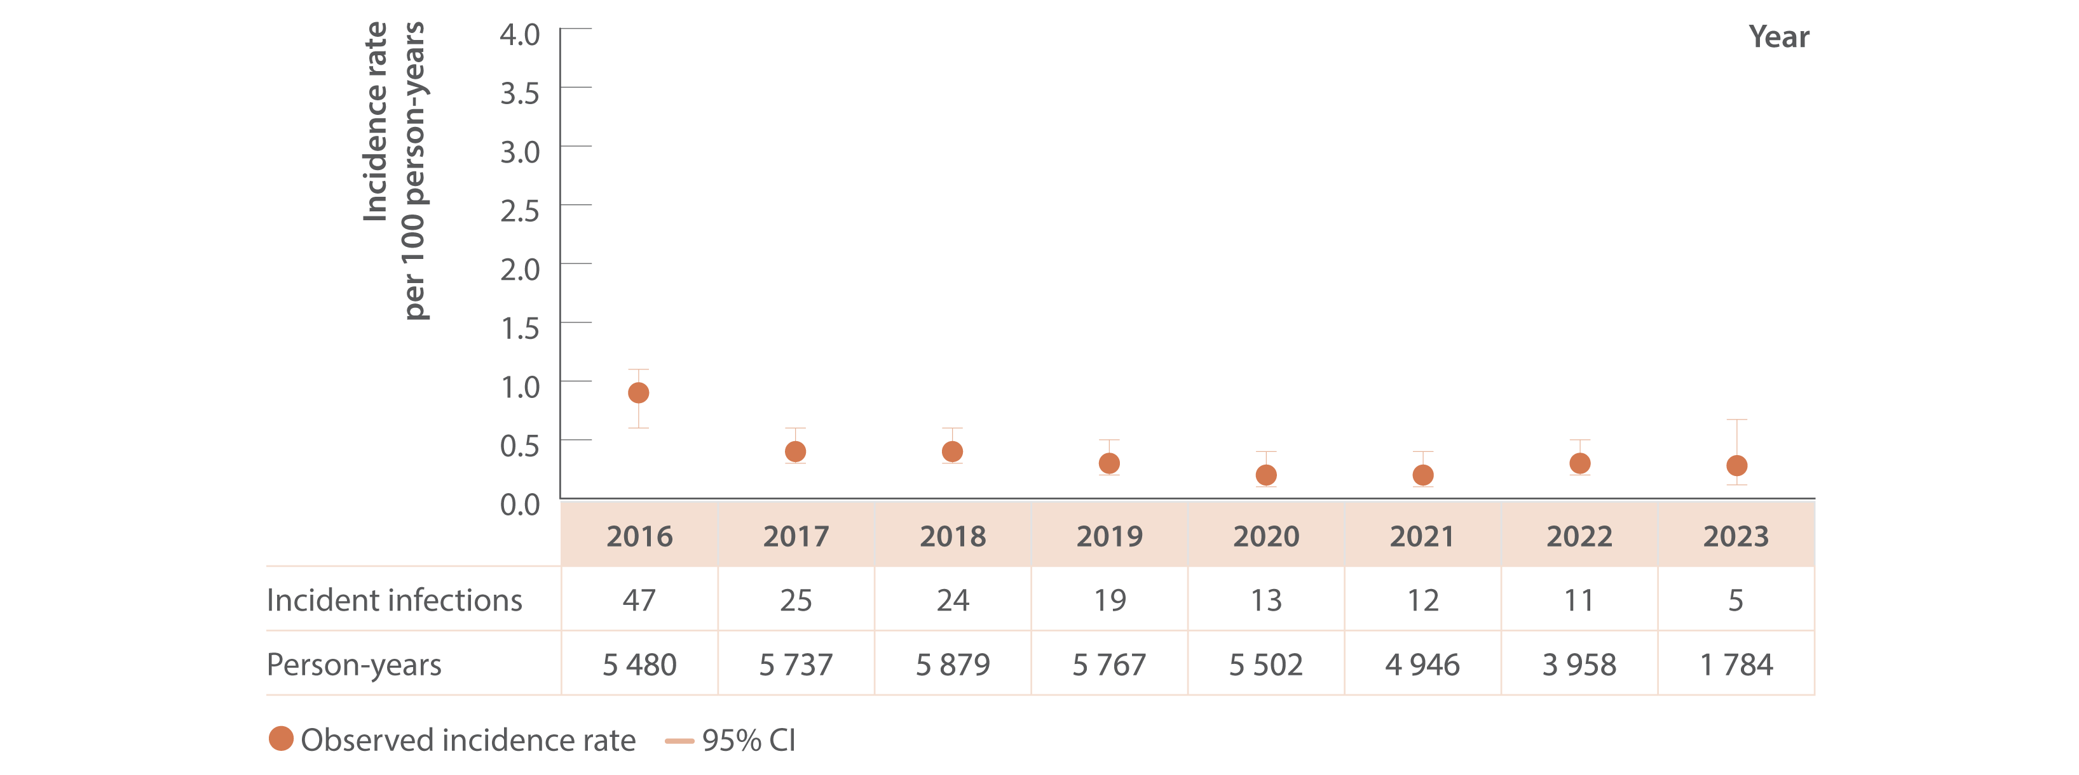
Figure 3. Incidence of primary hepatitis C infection among HIV‑positive GBM tested at ACCESS GBM or sexual health clinics, ACCESS, 2016–2023
New infections
Source: ACCESS.⁽¹¹⁾
Notes:
Notes: Analysis includes N=9 157 individuals, 73 989 tests (2009–2023) with data from 2016 shown for brevity. Analysis includes 23 sites: 12 in New South Wales (NSW), four in VIC, two in South Australia (SA), two in WA, two in QLD, and one in Tasmania (TAS). GBM were classed as being HIV‑positive for the entire calendar year of their diagnosis and were 15 years or older. First incident infection only included in analysis. Incident infection date was assigned as the midpoint between the positive HCV antibody or HCV RNA test date and previous HCV antibody negative test date. ACCESS collates data from January 2009. Individuals included tested HCV antibody negative on their first test observed and had at least one follow‑up test (HCV antibody or HCV RNA or both) on or before 31 December 2023. CI: confidence interval.

Slide 14
Chapter two
Testing and diagnosis

Slide 15
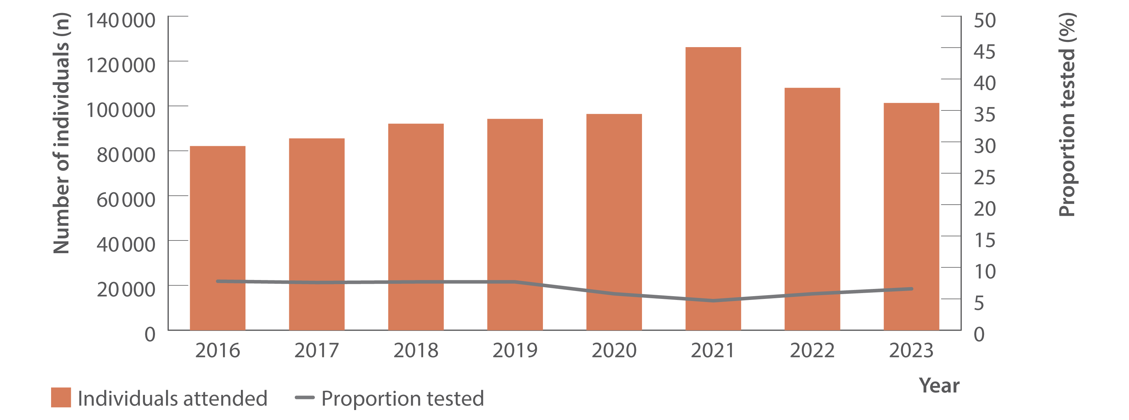
Figure 4. Number of individuals attending ACCESS primary care clinics and proportion tested for HCV (HCV antibody only or HCV antibody and RNA or HCV RNA only), ACCESS, 2016–2023
Testing and diagnosis
Source: ACCESS.⁽¹¹⁾
Notes:
Notes: Analysis includes 16 sites: 14 in VIC, one in WA, and one in QLD. Primary care clinics see high caseloads of people at risk of hepatitis C and provide both specialist services to current or former people who inject drugs as well as general health services. Clinic attendances included in‑person and telehealth consultations. Individuals were 15 years or older and contributed one consultation and one test per year.

Slide 16
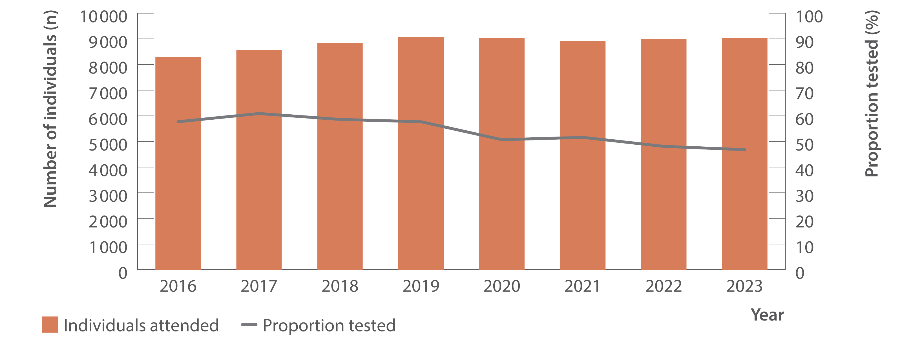
Figure 5. Number of HIV‑positive GBM attending ACCESS GBM or sexual health clinics and proportion tested for HCV (HCV antibody only or HCV antibody and RNA or HCV RNA only), ACCESS, 2016–2023
Testing and diagnosis
Source: ACCESS.⁽¹¹⁾
Notes:
Notes: Analysis includes 23 sites: 12 in NSW, four in VIC, two in SA, two in WA, two in QLD, and one in TAS. Clinic attendances included in‑person and telehealth consultations. GBM were classed as being HIV‑positive for the entire calendar year of their diagnosis, were 15 years or older, and contributed one consultation and one test per year.

Slide 17
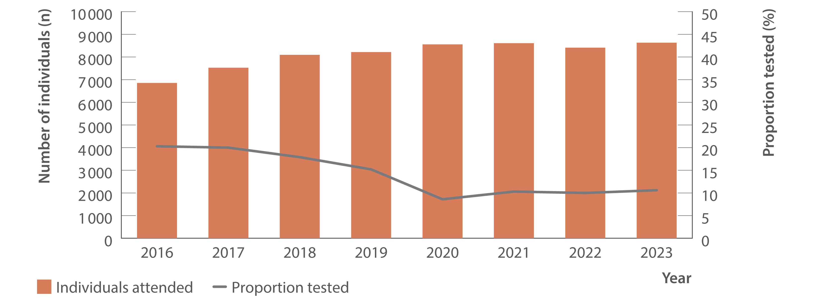
Figure 6. Number of individuals ever prescribed opioid agonist therapy attending ACCESS primary care clinics and proportion tested for HCV (HCV antibody only or HCV antibody and RNA or HCV RNA only), ACCESS, 2016–2023
Testing and diagnosis
Source: ACCESS.⁽¹¹⁾
Notes:
Notes: Analysis includes 16 sites: 14 in VIC, one in WA, and one in QLD. Primary care clinics have high caseloads of people at risk of hepatitis C and provide both specialist services to current and former people who inject drugs as well as general health services. Clinic attendances included in‑person and telehealth consultations. Individuals were 15 years or older, had at least one electronic medical record of a prescription for opioid agonist therapy between January 2009 and December 2023, and contributed one consultation and one test per year.

Slide 18
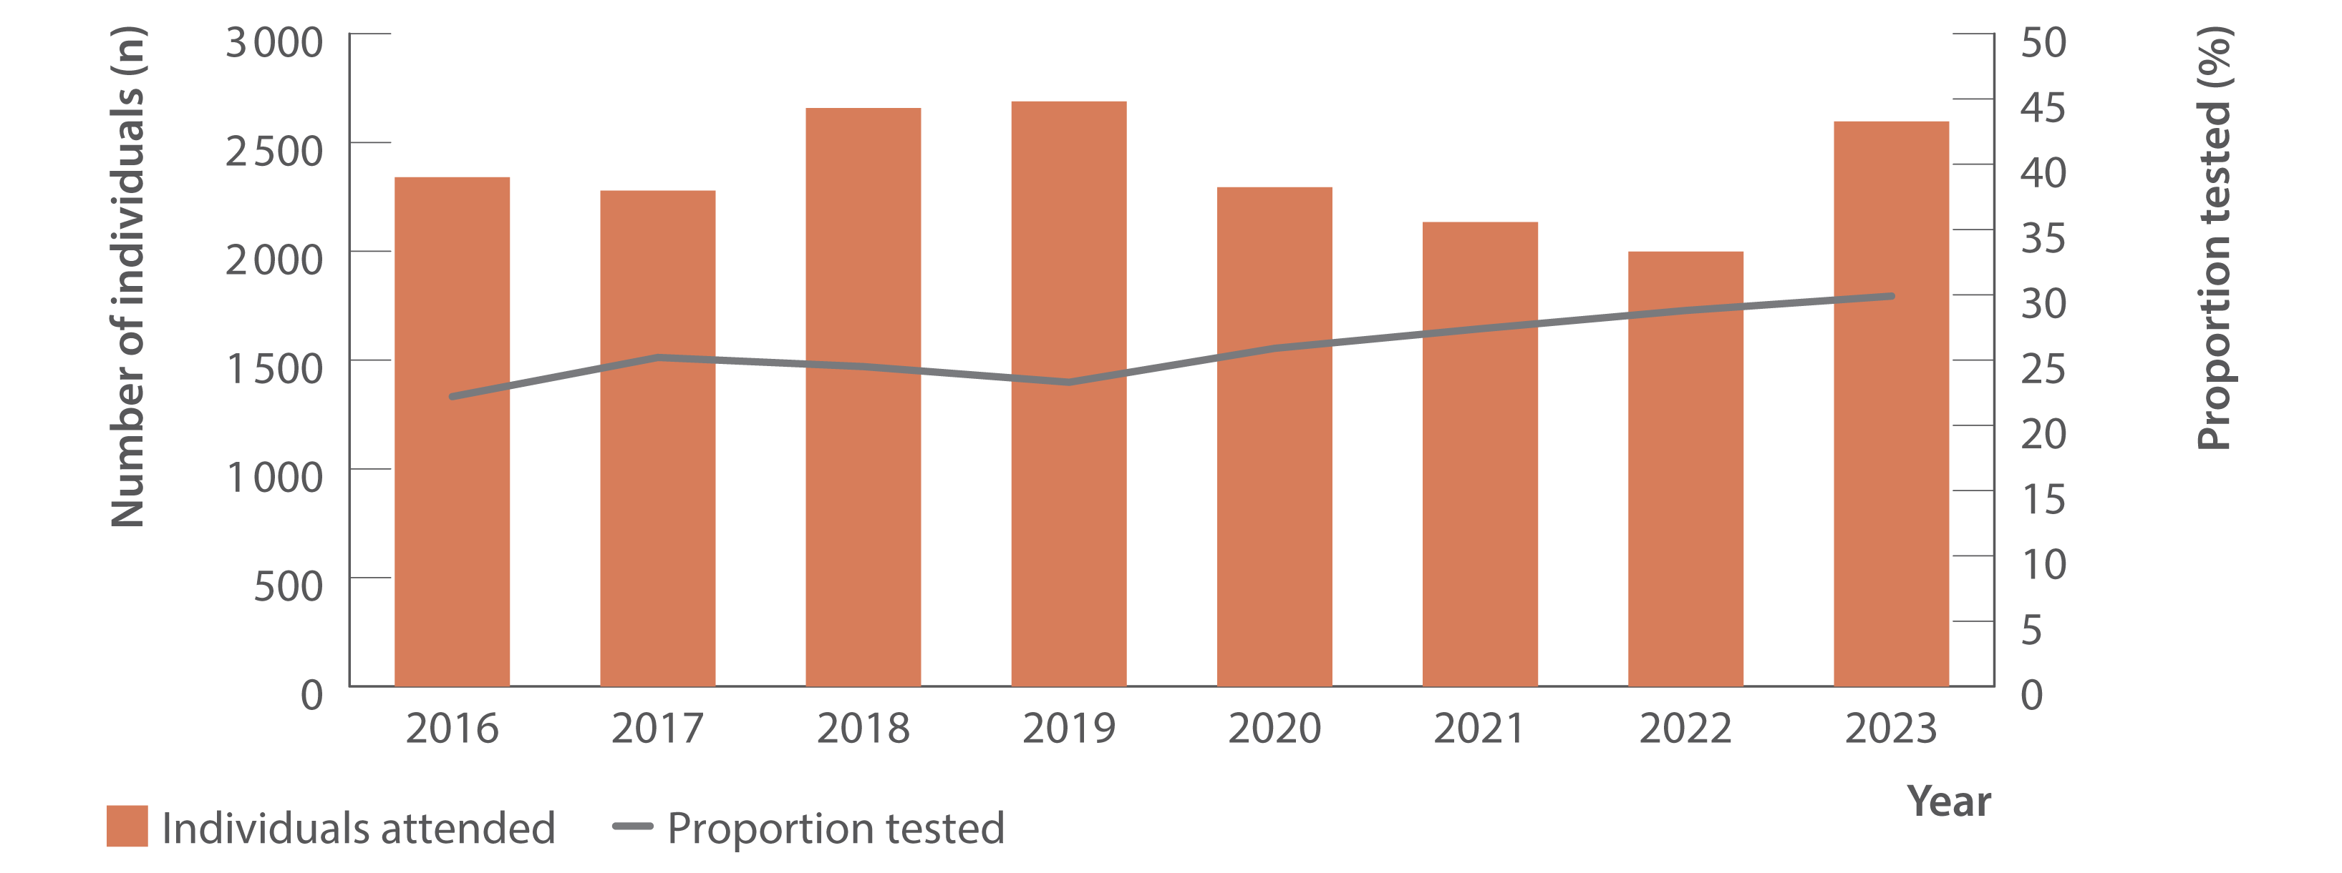
Figure 7. Number of Aboriginal and/or Torres Strait Islander people attending ACCESS sexual health clinics and proportion tested for HCV (HCV antibody only or HCV antibody and RNA or HCV RNA only), ACCESS, 2016–2023
Testing and diagnosis
Source: ACCESS.⁽¹¹⁾
Notes:
Notes: Analysis includes 11 sites: seven in NSW, two in QLD, one in VIC, and one in SA. Clinic attendances included in‑person and telehealth consultations. Individuals were 15 years or older and contributed one consultation and one test per year. Overall, of unique individuals who attended included clinics 2013–2023 for a consultation (N=398 095), 8% of people had no Aboriginal or Torres Strait Islander status recorded (missing), 6% were recorded as `not stated’, 82% were neither Aboriginal nor Torres Strait Islander people, and 4% were Aboriginal and Torres Strait Islander people).

Slide 19
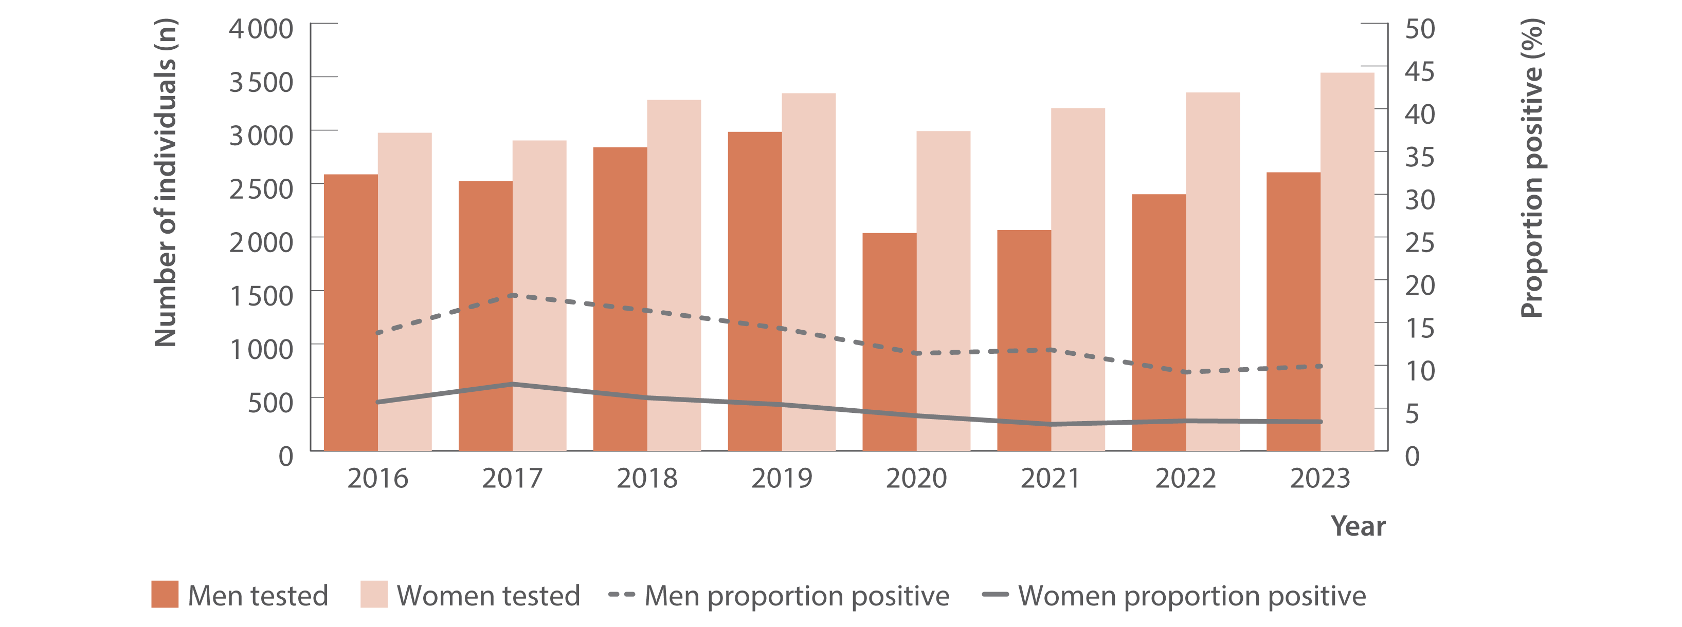
Figure 8. Number of individuals tested for HCV antibody at ACCESS primary care clinics and proportion of HCV antibody tests positive by gender, ACCESS, 2016–2023
Testing and diagnosis
Source: ACCESS.⁽¹¹⁾
Notes:
Notes: Analysis includes 16 sites: 14 in VIC, one in WA, and one in QLD. Primary care clinics have high caseloads of people at risk of hepatitis C and provide both specialist services to current and former people who inject drugs as well as general health services. Individuals were 15 years or older and contributed one test per year. Individuals recorded as a gender other than man or woman were not reported due to small sample size. Individuals included either had no previous HCV antibody test recorded in ACCESS since 2009 or had previously tested HCV antibody negative. Individual’s HCV antibody tests after an HCV antibody positive test being observed were excluded from analysis.

Slide 20
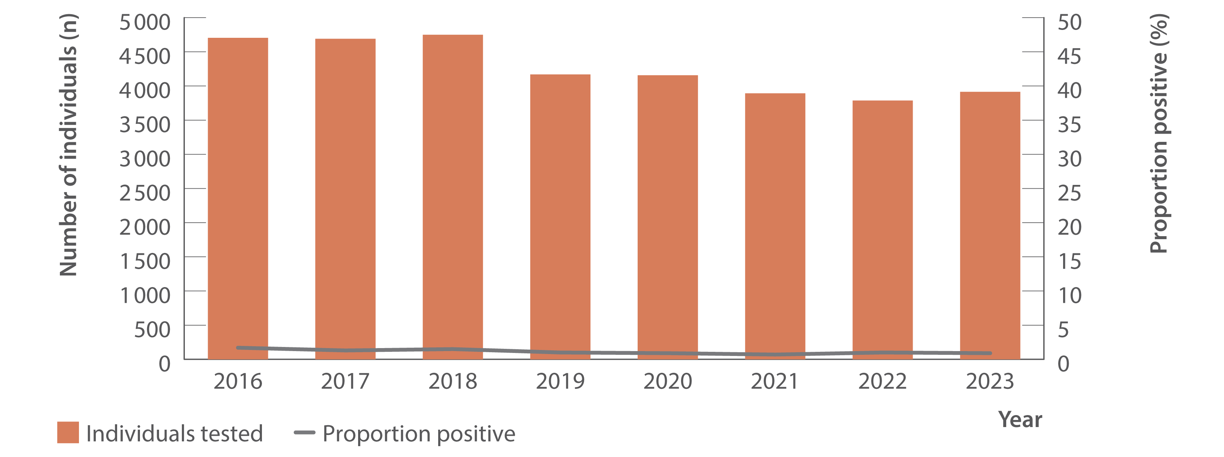
Figure 9. Number of HIV‑positive GBM tested for HCV antibody at ACCESS GBM or sexual health clinics and proportion of HCV antibody tests positive, ACCESS, 2016–2023
Testing and diagnosis
Source: ACCESS.⁽¹¹⁾
Notes:
Notes: Analysis includes 23 sites: 12 in NSW, four in VIC, two in SA, two in WA, two in QLD, and one in TAS. GBM were classed as being HIV‑positive for the entire calendar year of their diagnosis, were 15 years or older, and contributed one test per year. Individuals included either had no previous HCV antibody test recorded in ACCESS since 2009 or had previously tested HCV antibody negative. Individual’s HCV antibody tests after an HCV antibody positive test being observed were excluded from analysis.

Slide 21
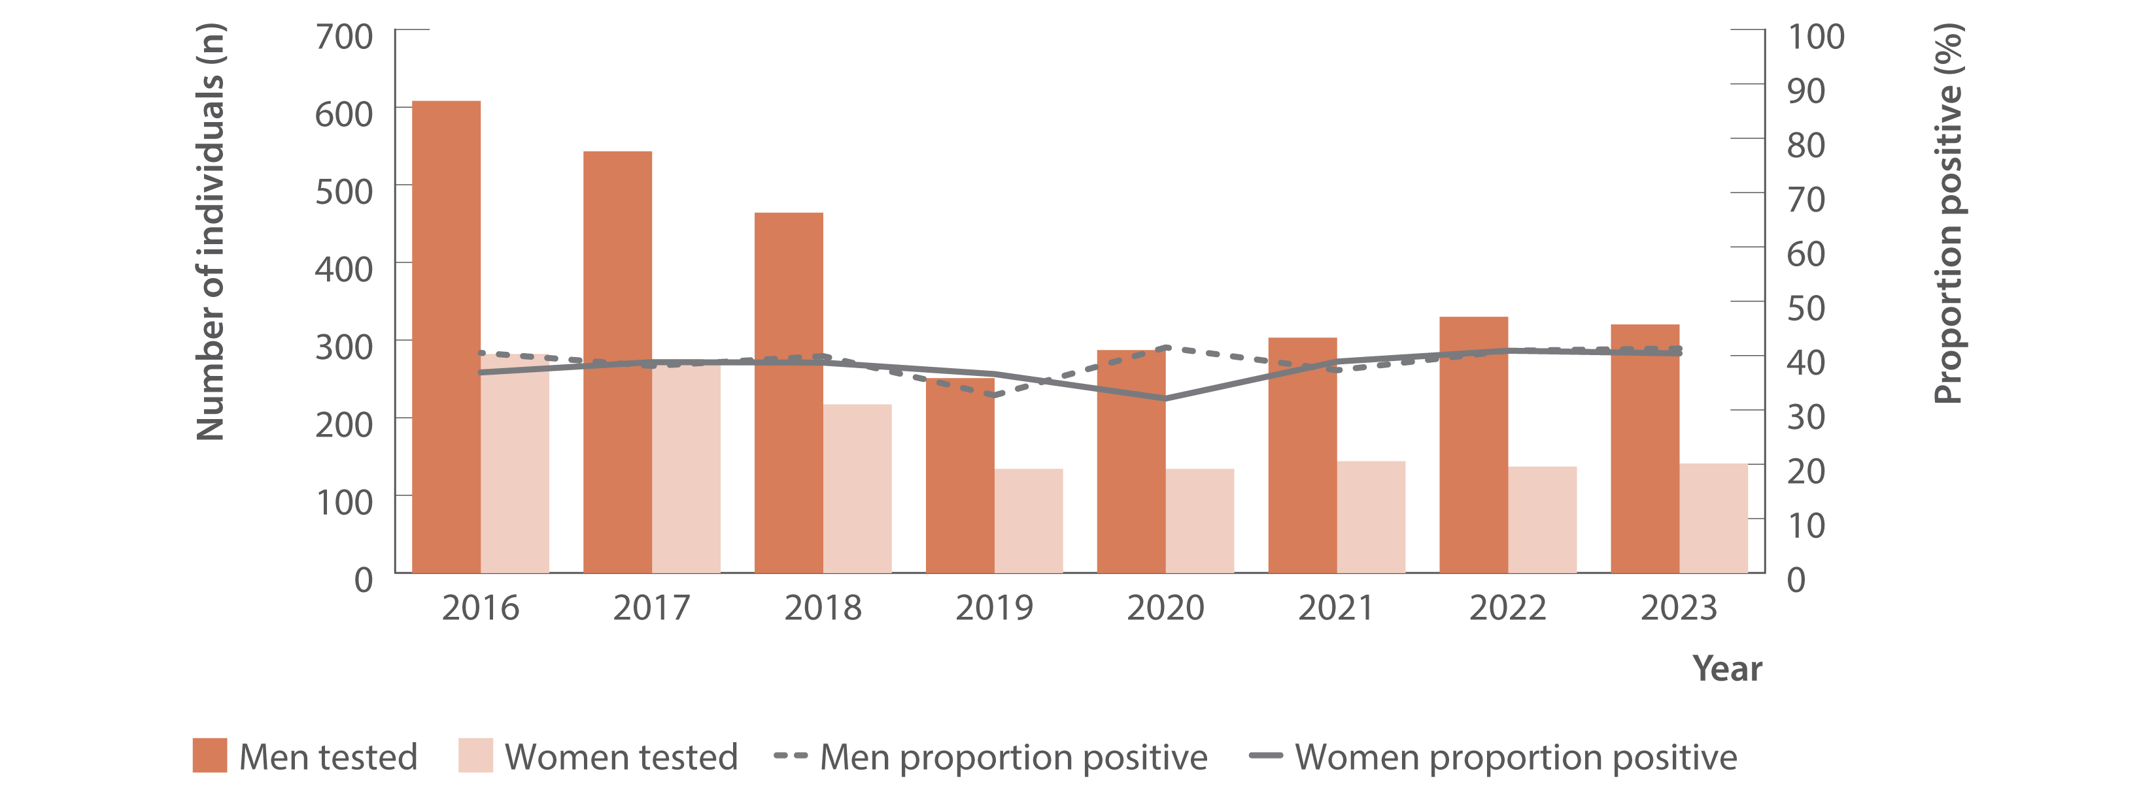
Figure 10. Number of individuals ever prescribed opioid agonist therapy tested for HCV antibody at ACCESS primary care clinics and proportion of HCV antibody tests positive by gender, ACCESS, 2016–2023
Testing and diagnosis
Source: ACCESS.⁽¹¹⁾
Notes:
Notes: Analysis includes 16 sites: 14 in VIC, one in WA, and one in QLD. Primary care clinics have high caseloads of people at risk of hepatitis C and provide both specialist services to current and former people who inject drugs as well as general health services. Individuals were 15 years or older, had at least one electronic medical record of a prescription for opioid agonist therapy between January 2009 and December 2023, and contributed one test per year. Individuals recorded as a gender other than man or woman were not reported due to small sample size. Individuals included either had no previous HCV antibody test recorded in ACCESS since 2009 or had previously tested HCV antibody negative. Individual’s HCV antibody tests after an HCV antibody positive test being observed were excluded from analysis.

Slide 22
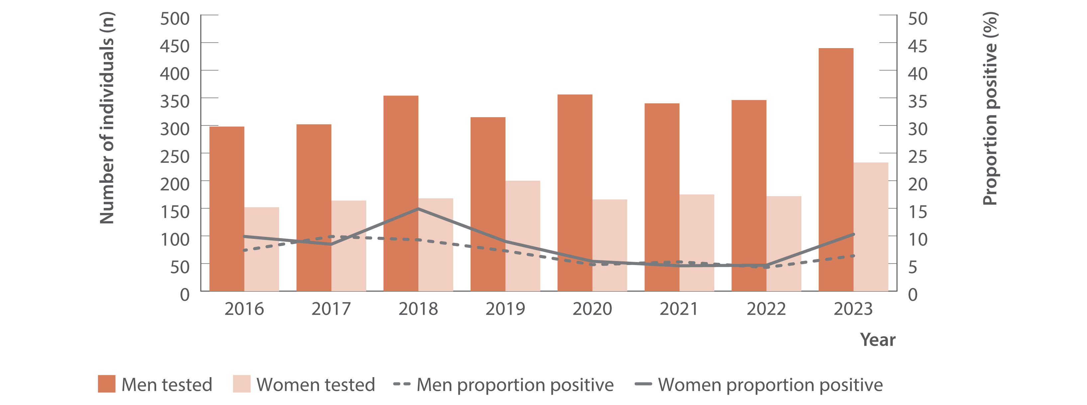
Figure 11. Number of Aboriginal and/or Torres Strait Islander people tested for HCV antibody at ACCESS sexual health clinics and proportion of HCV antibody tests positive, ACCESS, 2016–2023
Testing and diagnosis
Source: ACCESS.⁽¹¹⁾
Notes:
Notes: Analysis includes 11 sites: seven in NSW, two in QLD, one in VIC, and one in SA. Individuals were 15 years or older and contributed one test per year. Individuals recorded as a gender other than man or woman were not reported due to small sample size. Individuals included either had no previous HCV antibody test recorded in ACCESS since 2009 or had previously tested HCV antibody negative. Individual’s HCV antibody tests after an HCV antibody positive test being observed were excluded from analysis.

Slide 23
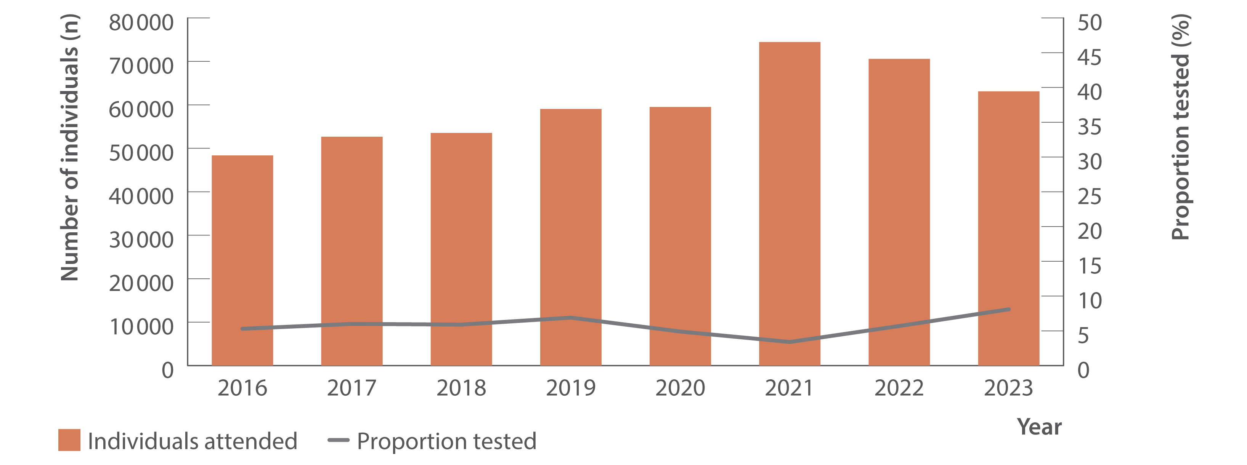
Figure 12. Number of individuals attending ACCHS and proportion tested for HCV (HCV antibody only or HCV antibody and RNA or HCV RNA only), ATLAS network, 2016–2023
Testing and diagnosis
Source: ATLAS Indigenous Primary Care Surveillance and Research Network, 2016–2023.⁽¹⁸⁾
Notes:
Notes: Individuals defined as people aged 15 years or older, who visited a doctor, nurse, or Aboriginal health practitioner (‘medical consultations’) between 2016 and 2023.

Slide 24
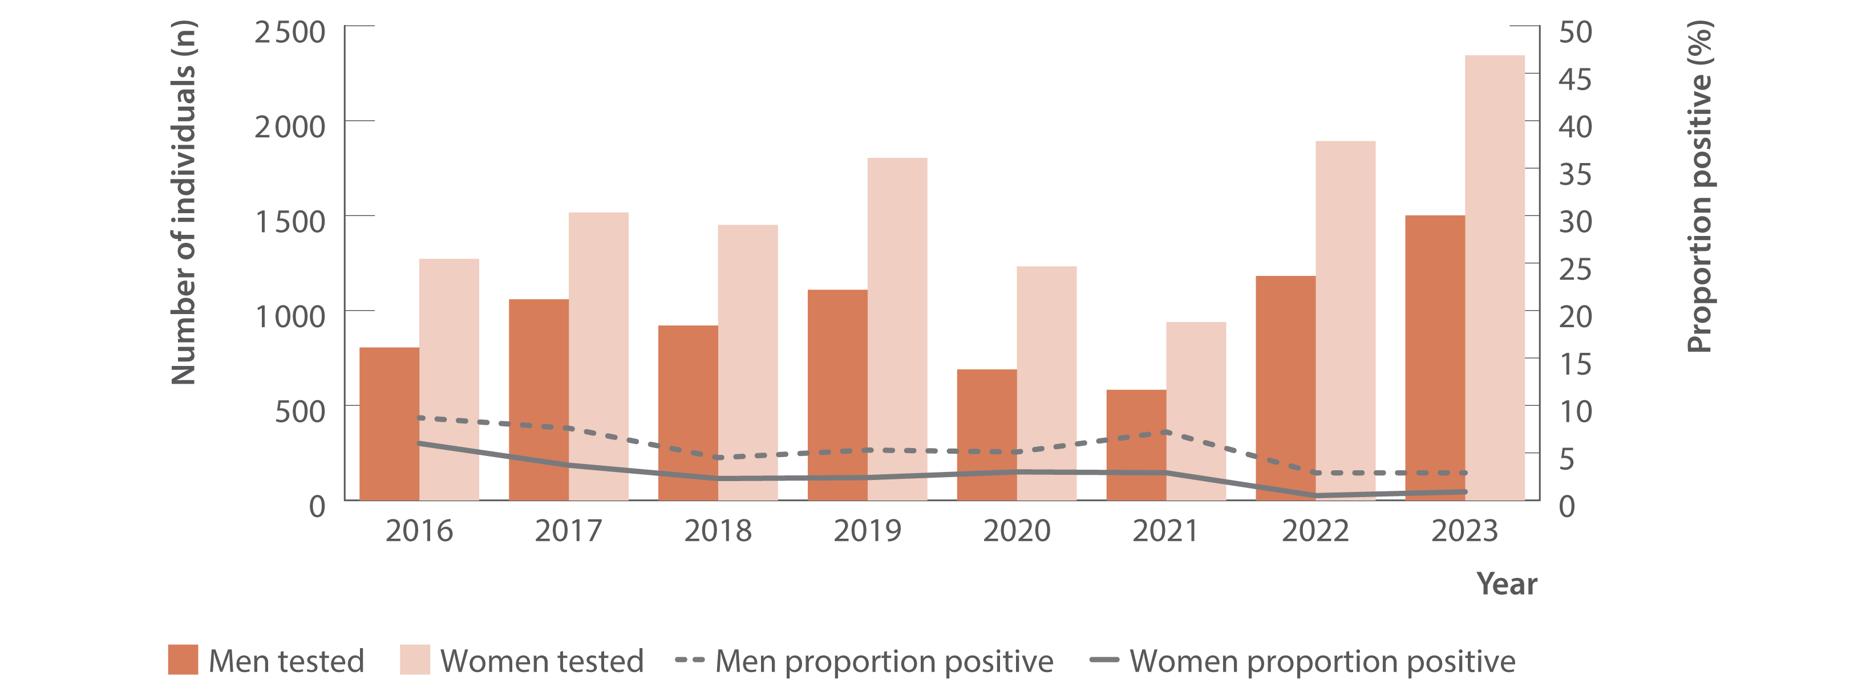
Figure 13. Number of individuals attending ACCHS tested for HCV antibody and proportion positive by gender, ATLAS network, 2016–2023
Testing and diagnosis
Source: ATLAS Indigenous Primary Care Surveillance and Research Network, 2016–2023.⁽¹⁸⁾
Notes:
Notes: Individuals defined as people aged 15 years or older, who visited a doctor, nurse, or Aboriginal health practitioner (‘medical consultations’) between 2016 and 2023. Number of people tested per year as follows: 2016: 805 men, 1 272 women; 2017: 1 059 men, 1 516 women; 2018: 921 men, 1 451 women; 2019: 1 109 men, 1 804 women; 2020: 690 men, 1 232 women; 2021: 582 men, 939 women; 2022: 1 182 men, 1 892 women; 2023: 1 501 men, 2 344 women.

Slide 25
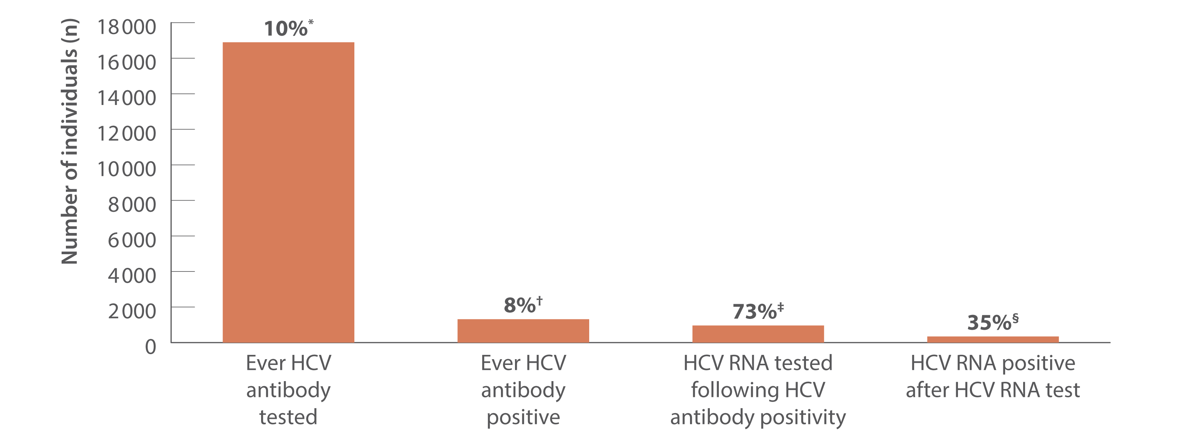
Figure 14. Hepatitis C testing cascade: number and proportion of individuals attending ACCHS tested for HCV antibody or RNA and among those tested, the number and proportion testing positive, ATLAS network, aggregated for years 2016–2023
Testing and diagnosis
Source: ATLAS Indigenous Primary Care Surveillance and Research Network, 2016–2023.⁽¹⁸⁾
Notes:
Notes: Individuals defined as people aged 15 years or older, who visited a doctor, nurse, or Aboriginal health practitioner (‘medical consultations’) between 2016 and 2023. ‘Ever HCV antibody positive’ was defined as having had a positive test result at any time since data collection began (1st January 2016) until end of the sample period (December 2023). *A total of 178 816 individuals aged 15 years or older attended medical appointments between 2016 and 2023, of whom 9.5% (16 899/178 816) had an HCV antibody test. †Of those tested for HCV antibody, 7.8% (1 316/16 899) tested HCV antibody positive. ‡Of those HCV antibody positive, 73.0% (961/1 316) had an HCV RNA test following HCV antibody positivity of which §35.5% (341/961) were HCV RNA positive.

Slide 26
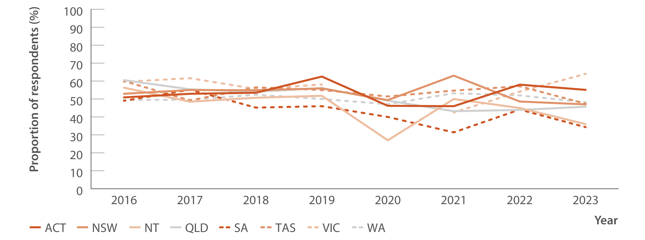
Figure 15. Proportion of Australian Needle Syringe Program Survey respondents self‑reporting recent (past 12 months) hepatitis C testing by jurisdiction, 2016–2023
Testing and diagnosis
Source: Australian Needle Syringe Program Survey. 25-year National Data Report 1995–2019.⁽²⁶⁾ Australian Needle Syringe Program Survey. National Data Report 2019–2023.⁽¹⁹⁾
Notes:
Notes: No participant recruitment occurred in VIC in 2020.

Slide 27
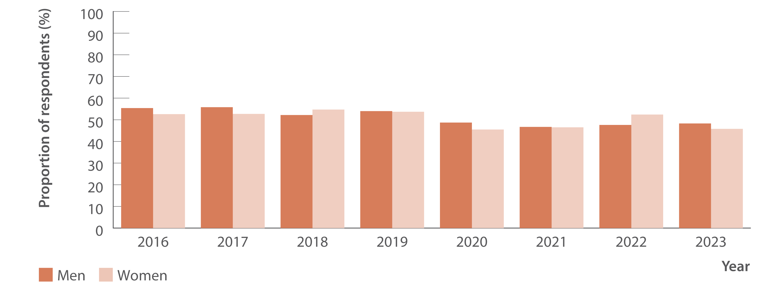
Figure 16. Proportion of Australian Needle Syringe Program Survey respondents reporting recent (past 12 months) hepatitis C testing by gender, 2016–2023
Testing and diagnosis
Source: Australian Needle Syringe Program Survey. 25-year National Data Report 1995–2019.⁽²⁶⁾ Australian Needle Syringe Program Survey. National Data Report 2019–2023.⁽¹⁹⁾
Notes:
Notes: No participant recruitment occurred in VIC in 2020.

Slide 28
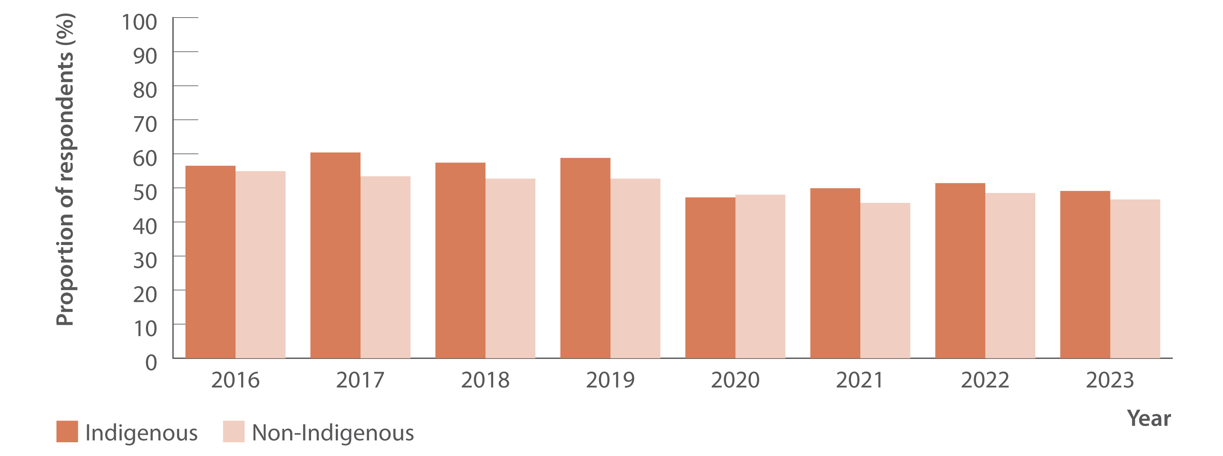
Figure 17. Proportion of Australian Needle Syringe Program Survey respondents reporting recent (past 12 months) hepatitis C testing by Indigenous status, 2016–2023
Testing and diagnosis
Source: Australian Needle Syringe Program Survey. 25-year National Data Report 1995–2019.⁽²⁶⁾ Australian Needle Syringe Program Survey. National Data Report 2019–2023.⁽¹⁹⁾
Notes:
Notes: No participant recruitment occurred in VIC in 2020.

Slide 29
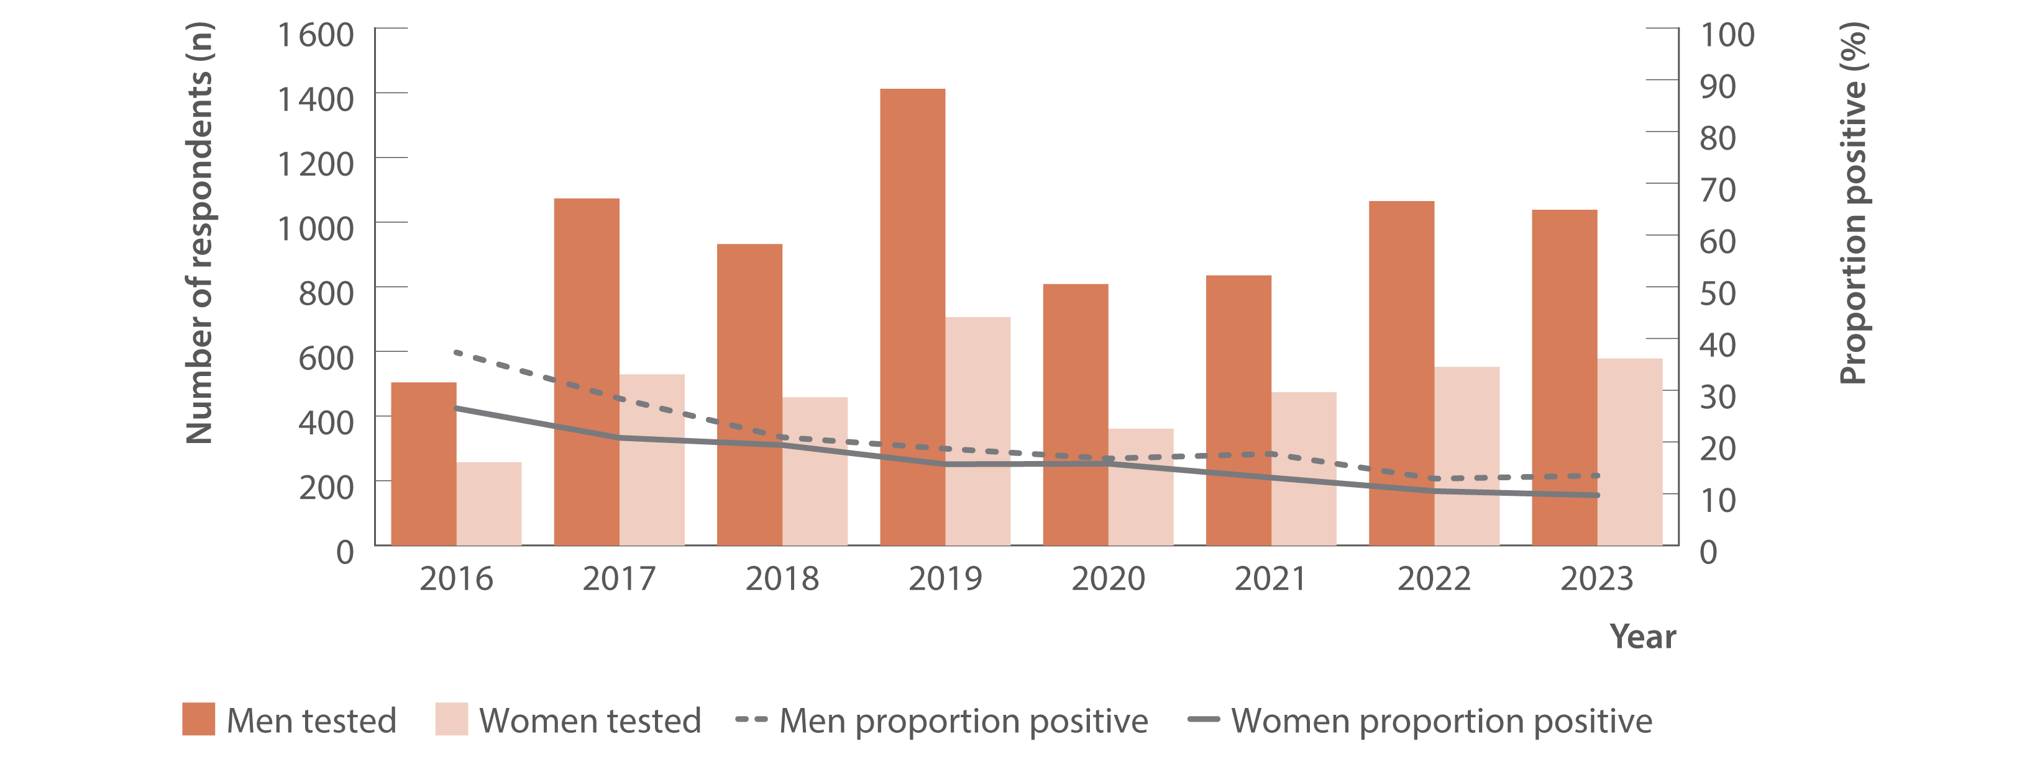
Figure 18. Number of Australian Needle Syringe Program Survey respondents tested for HCV RNA and proportion positive by gender, 2016–2023
Testing and diagnosis
Source: Australian Needle Syringe Program Survey. 25-year National Data Report 1995–2019.⁽²⁶⁾ Australian Needle Syringe Program Survey. National Data Report 2019–2023.⁽¹⁹⁾
Notes:
Notes: No participant recruitment occurred in VIC in 2020. Weighted for gender and HCV antibody status 2015–2019.

Slide 30
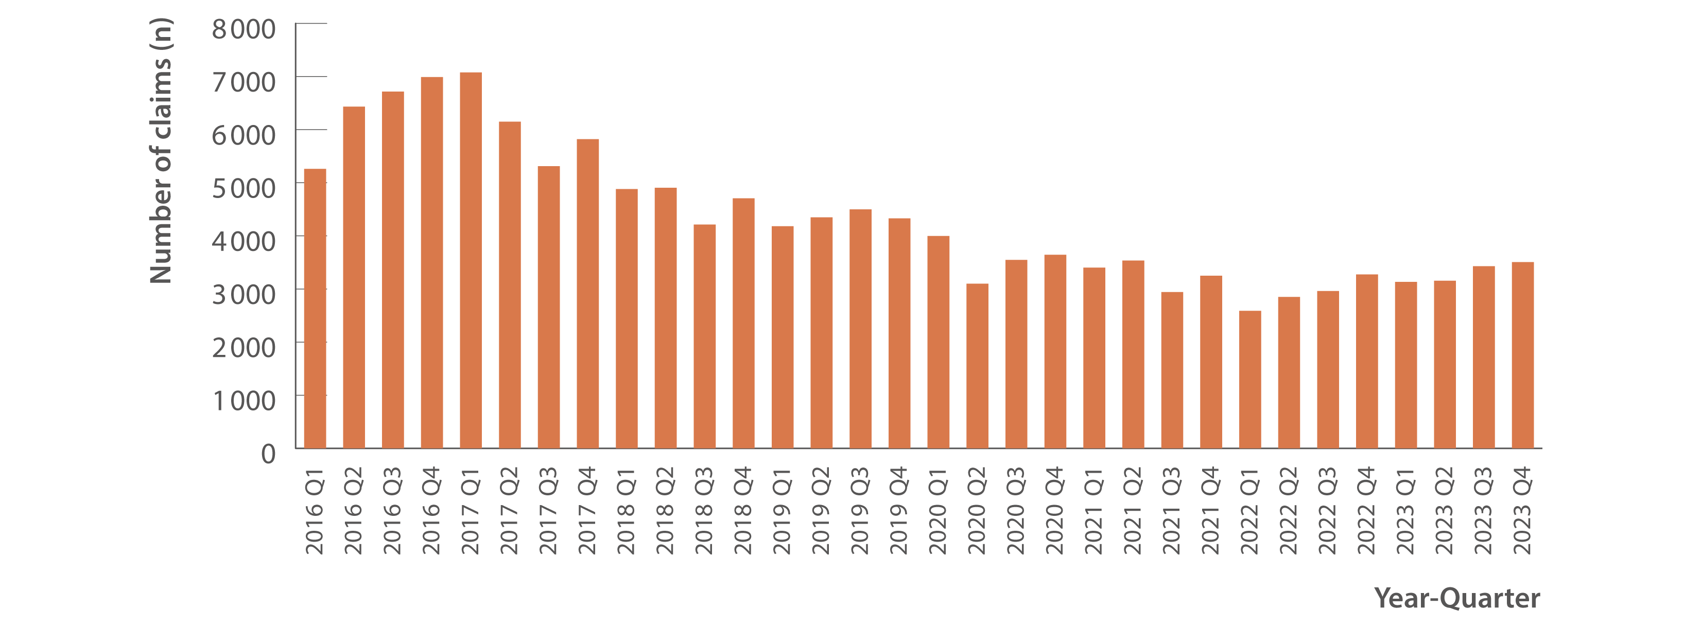
Figure 19. Number of claims to Medicare for items 69499 and 69500 (detection of HCV RNA, new infections only), 2016–2023
Testing and diagnosis
Source: Medicare Australia Statistics.⁽²⁰⁾
Notes:
Notes: Medicare Benefits Schedule item numbers (69499 and 69500) are used for testing to detect current hepatitis C infection which are not used for tests associated with treatment monitoring. Prison‑based testing not included in Medicare Benefits Schedule data.

Slide 31
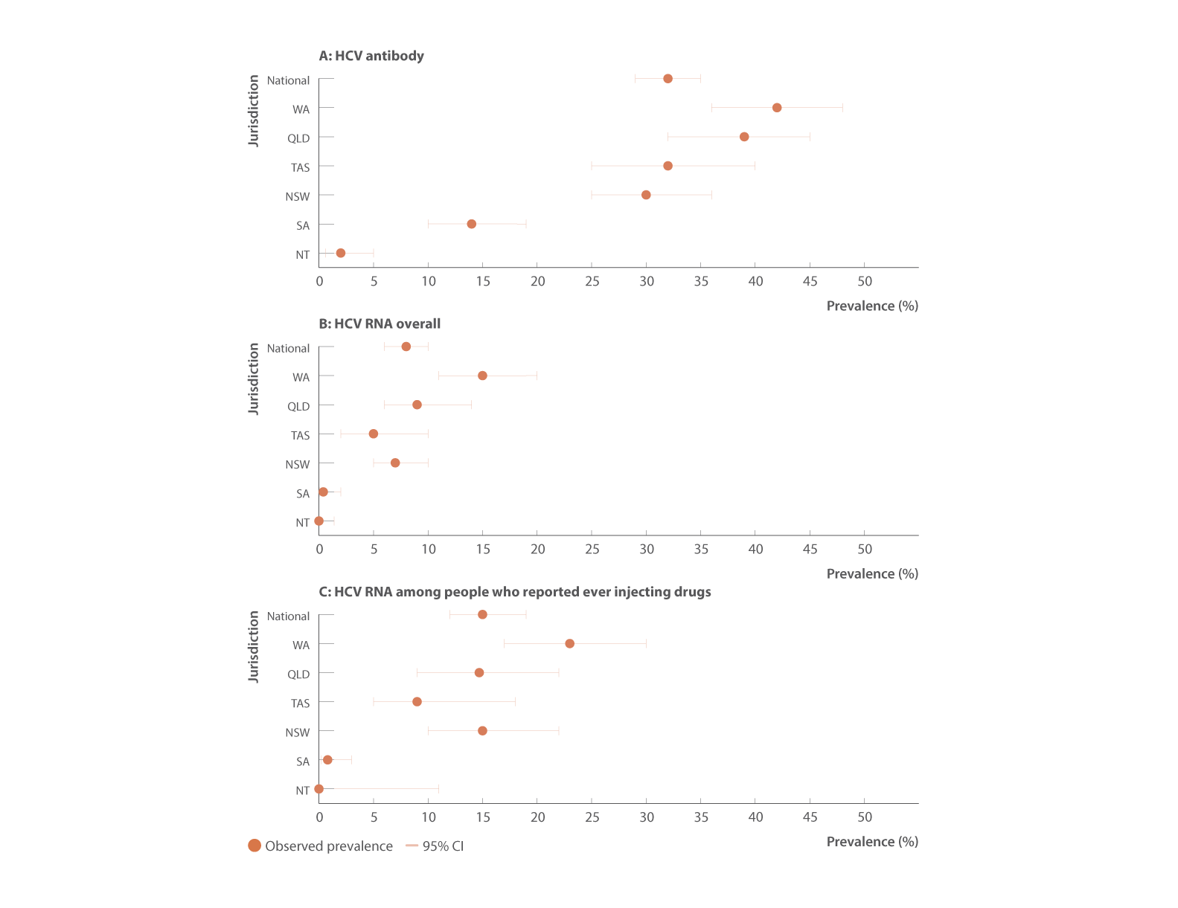
Figure 20. Prevalence of hepatitis C among people in prison by (A) HCV antibody, (B) HCV RNA overall, and (C) HCV RNA among people who reported ever injecting drugs, Australian Hepatitis and Risk Survey in Prisons, April 2022–June 2023
Testing and diagnosis
Source: Adapted from Bah et al., Int J Drug Policy 2024,⁽²³⁾ and Bah et al., The Lancet Reg Health Western Pac 2024.⁽²⁴⁾
Notes:
Notes: A total of 1 599 people in prison were enrolled and all participants were tested for HCV antibody. Participants who were HCV antibody positive were then tested for HCV RNA. The study sample sizes for each jurisdiction were: NT n=254; SA n=300; NSW n=327; TAS n=171; QLD n=248; WA n=299. For all of the national prevalence estimates, the sample size in each jurisdiction was weighted by the prisoner population size of that jurisdiction and the distribution of gender, and First Nations identity among people in prison, based on data from the Australian Bureau of Statistics in 2022.⁽²⁷⁾ CI: confidence interval.

Slide 32
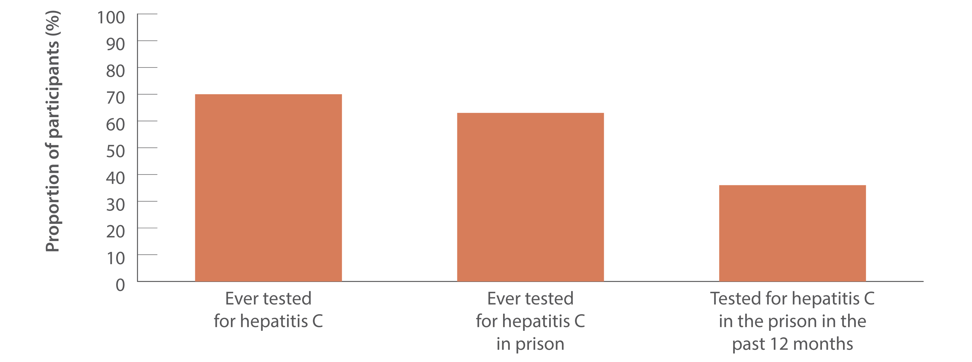
Figure 21. Proportion of people in prison self‑reporting any hepatitis C testing, Australian Hepatitis and Risk Survey in Prisons, April 2022–June 2023
Testing and diagnosis
Source: Adapted from Bah et al., Int J Drug Policy 2024,⁽²³⁾ and Bah et al., The Lancet Reg Health Western Pac 2024.⁽²⁴⁾

Slide 33
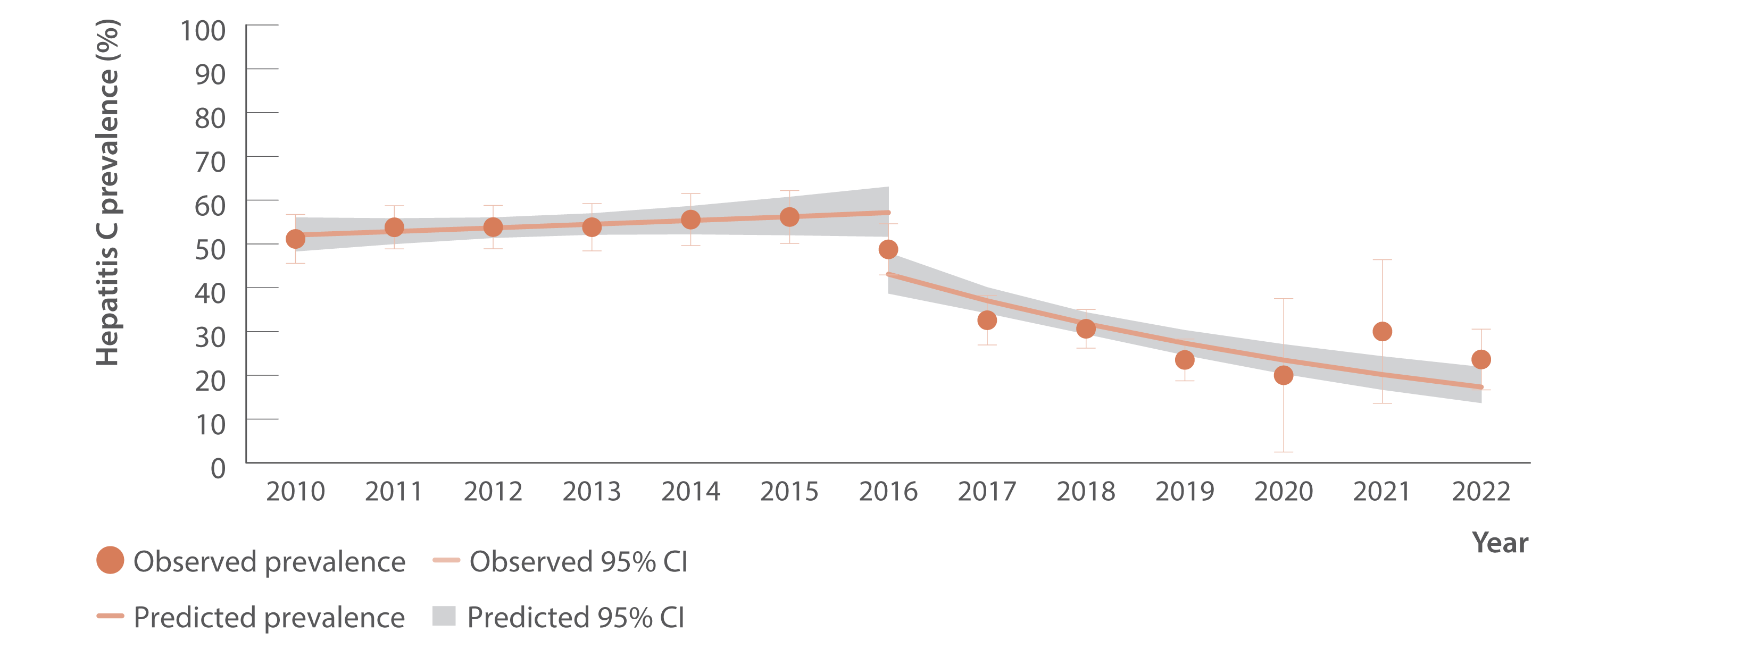
Figure 22. Proportion of people who inject drugs participating in the MIXMAX Melbourne Cohort HCV RNA positive before and after subsidisation of DAAs in March 2016, March 2010–December 2022
Testing and diagnosis
Source: Adapted from Fisher et al.⁽¹⁵⁾
Notes:
Notes: CI: confidence interval.

Slide 34
Chapter Three
Uptake of direct-acting antiviral treatment

Slide 35
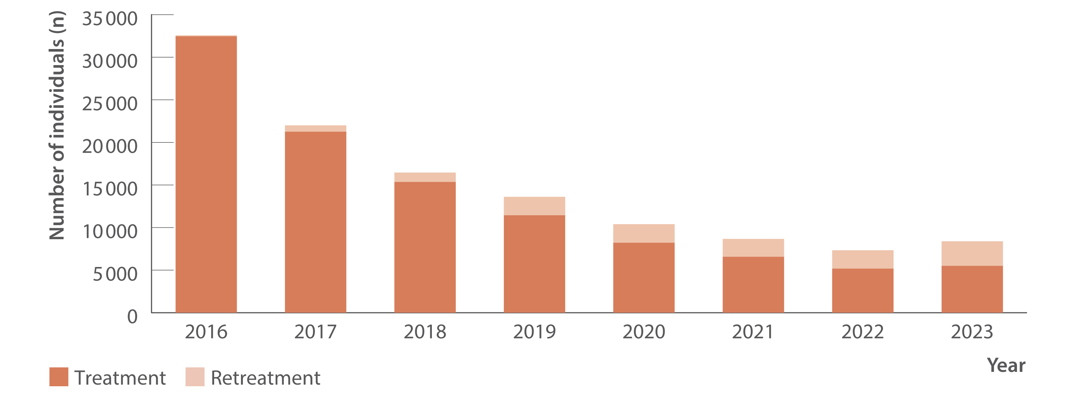
Figure 23. Total estimated number of individuals initiating DAA treatment (including retreatment), PBS database, March 2016–December 2023
Uptake of treatment
Source: Monitoring hepatitis C treatment uptake in Australia.⁽³¹⁾
Notes:
Notes: Treatment numbers may vary from previous or future reports due to refinements made to the PBS data between releases.

Slide 36
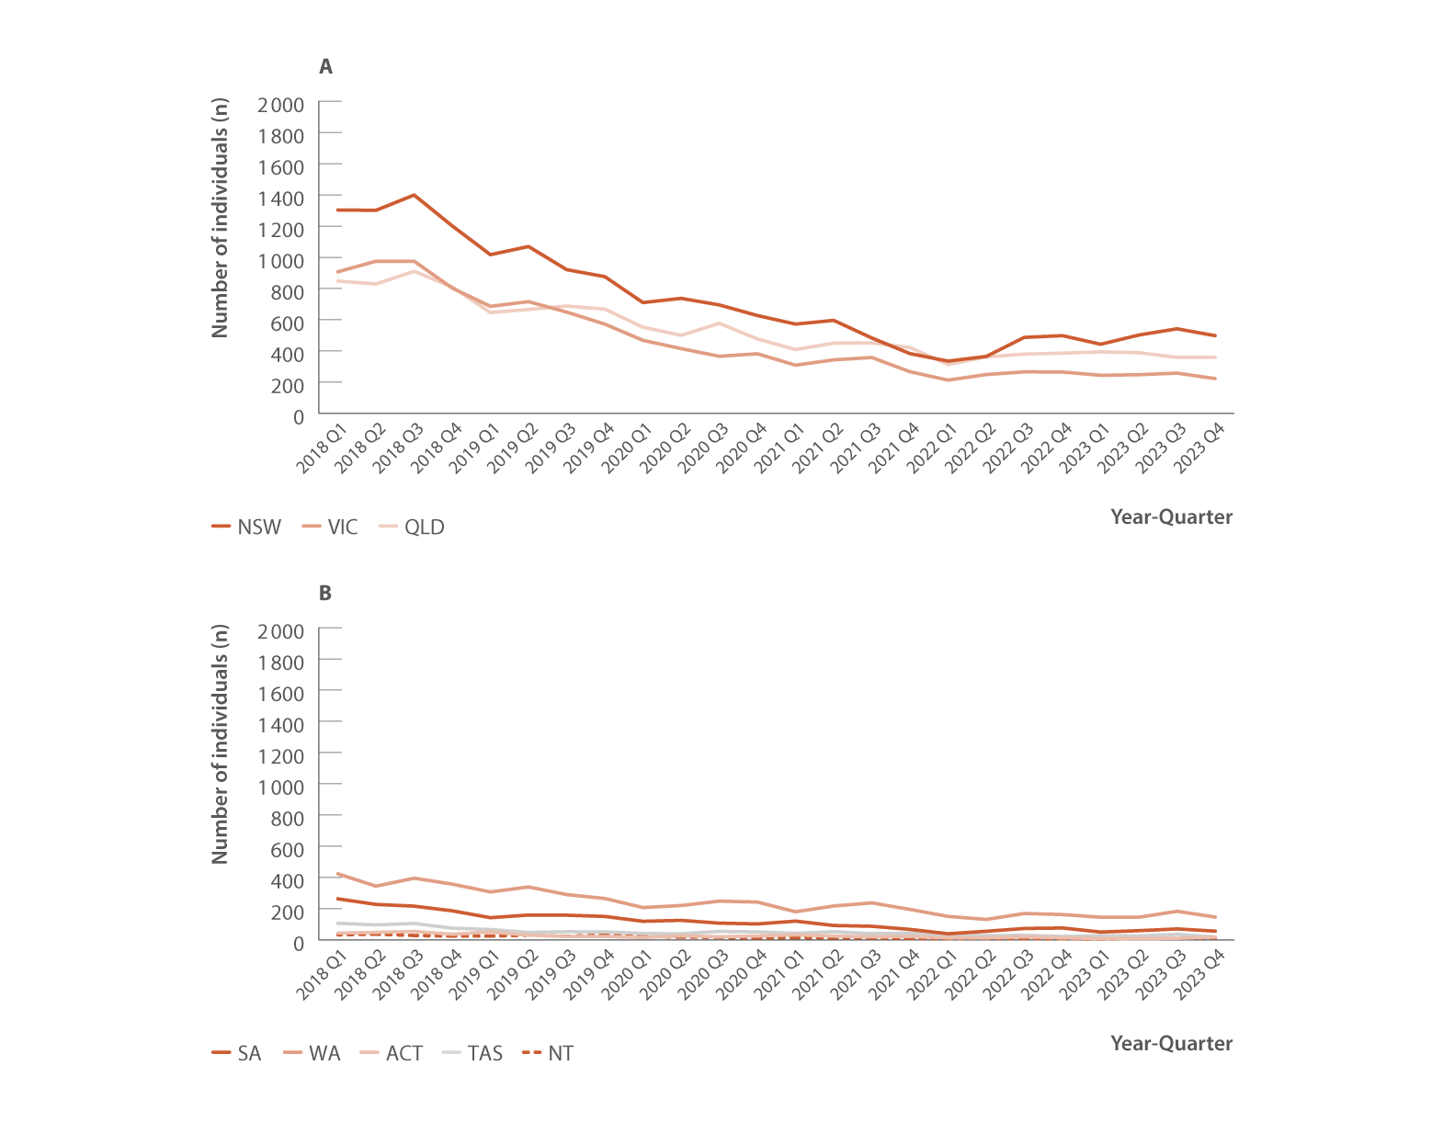
Figure 24. Estimated number of individuals initiating DAA treatment by jurisdiction, PBS database, 2018–2023
Uptake of treatment
Source: Monitoring hepatitis C treatment uptake in Australia.⁽³¹⁾
Notes:
Notes: Treatment numbers may vary from previous or future reports due to refinements made to the PBS data between releases.

Slide 37
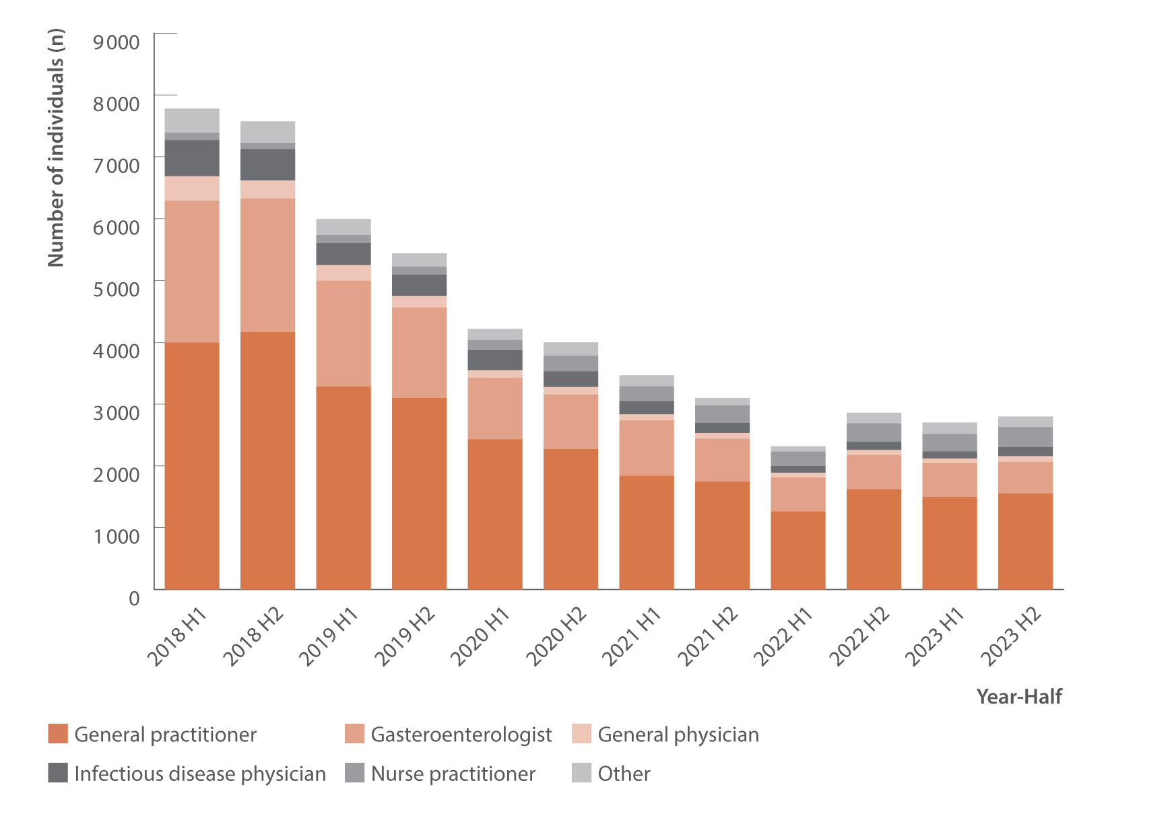
Figure 25. Estimated number of individuals initiating DAA treatment by prescriber type, PBS database, 2018–2023
Uptake of treatment
Source: Monitoring hepatitis C treatment uptake in Australia.(31)
Notes:
Notes: Treatment numbers may vary from previous or future reports due to refinements made to the PBS data between releases. Nurse practitioners have been authorised to prescribe DAA therapy for hepatitis C treatment since June 2017.

Slide 38
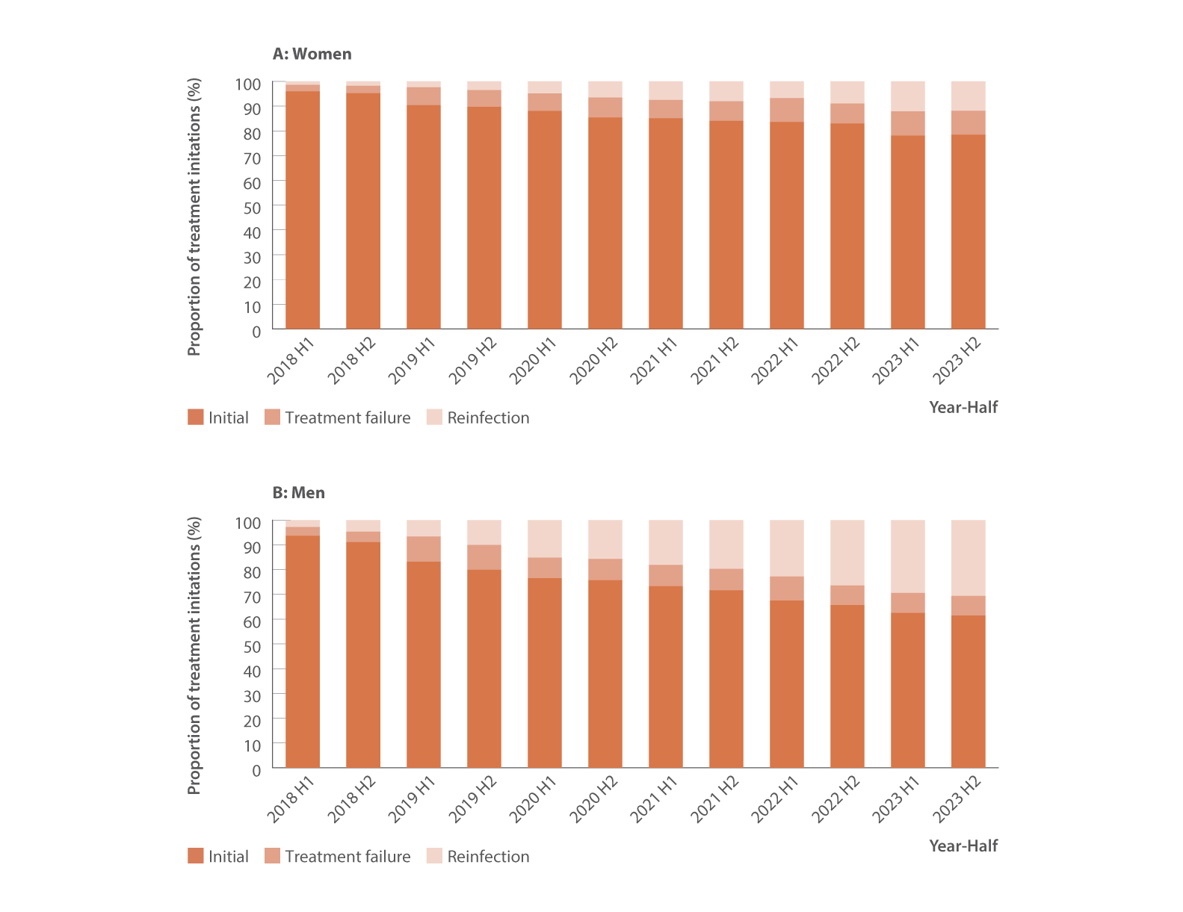
Figure 26. Estimated proportion of individuals initiating DAA treatment and retreatment by gender, PBS database, 2018–2023
Uptake of treatment
Source: Monitoring hepatitis C treatment uptake in Australia and National Retreatment Project.⁽³¹⁾
Notes:
Notes: Treatment numbers may vary from previous or future reports due to refinements made to the PBS data between releases.

Slide 39
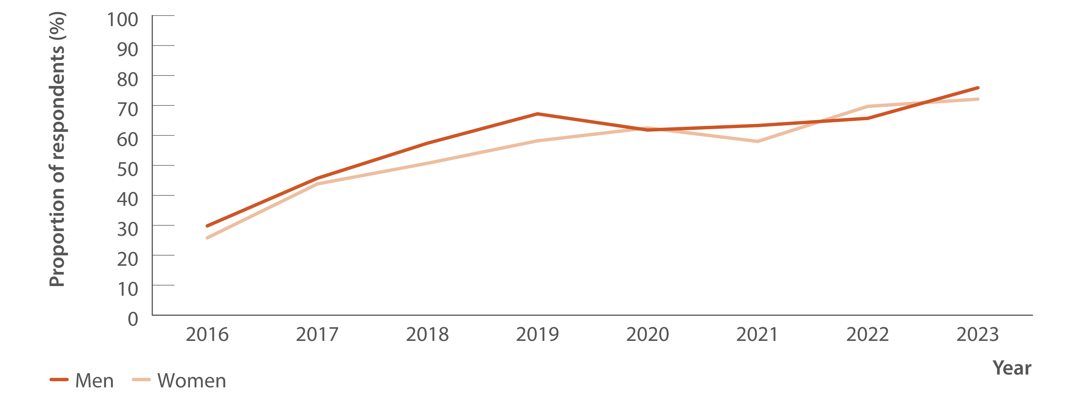
Figure 27. Proportion of Australian Needle Syringe Program Survey respondents who tested HCV antibody positive, self‑reporting lifetime history of hepatitis C treatment by gender, 2016–2023
Uptake of treatment
Source: Australian Needle Syringe Program Survey. 25-year National Data Report 1995–2019.⁽²⁶⁾ Australian Needle Syringe Program Survey. National Data Report 2019–2023.⁽¹⁹⁾
Notes:
Notes: Includes respondents who tested HCV antibody positive and excludes those self‑reporting spontaneous hepatitis C clearance. No participant recruitment occurred in VIC in 2020.

Slide 40
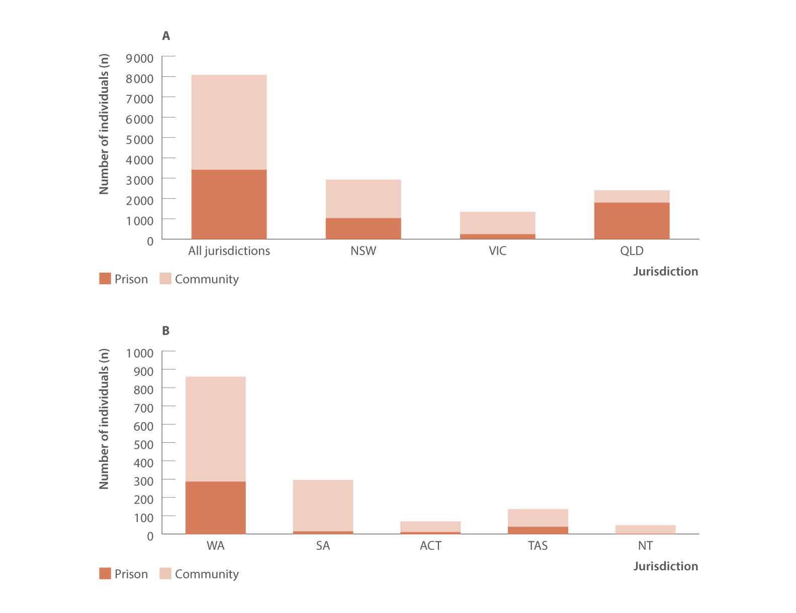
Figure 28. Number of individuals receiving DAA treatment in prison versus in the community nationally and by jurisdiction, National Prisons Hepatitis Network and PBS database, 2023
Uptake of treatment
Source: State and Territory Justice Health authorities via the National Prisons Hepatitis Network.⁽²²⁾ Monitoring treatment uptake in Australia.⁽³¹⁾

Slide 41
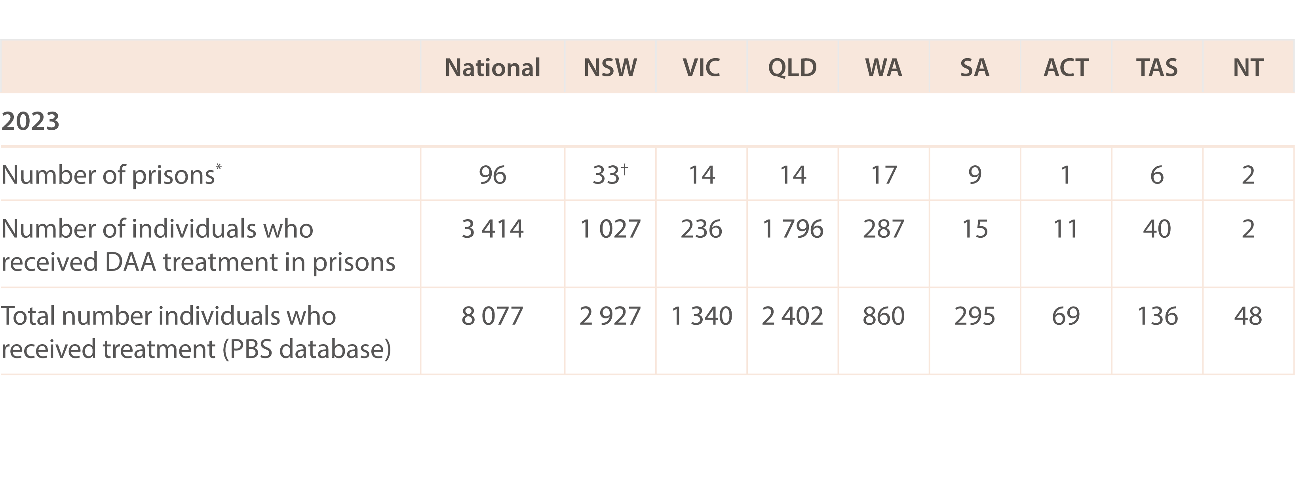
Table 1. Number of individuals who received DAA treatment in prison versus in the community, nationally and by jurisdiction, National Prisons Hepatitis Network and PBS database, 2023
Uptake of treatment
Source: State and Territory Justice Health authorities via the National Prisons Hepatitis Network.⁽²²⁾ Monitoring treatment uptake in Australia.⁽³¹⁾
Notes:
Notes: *Number of adult prisons in the network. †Data were collected from 30 prisons. The proportion of all people treated in prisons nationally was calculated using the number of people who initiated treatment reported by jurisdictional prison hepatitis services as a proportion of all people treated derived from the PBS database. ‘Community’ treatment initiations are therefore defined as all people treated in the PBS database minus all people treated reported by jurisdictional prison hepatitis services. Individuals are counted once per year and treatment may be first treatment or retreatment.

Slide 42
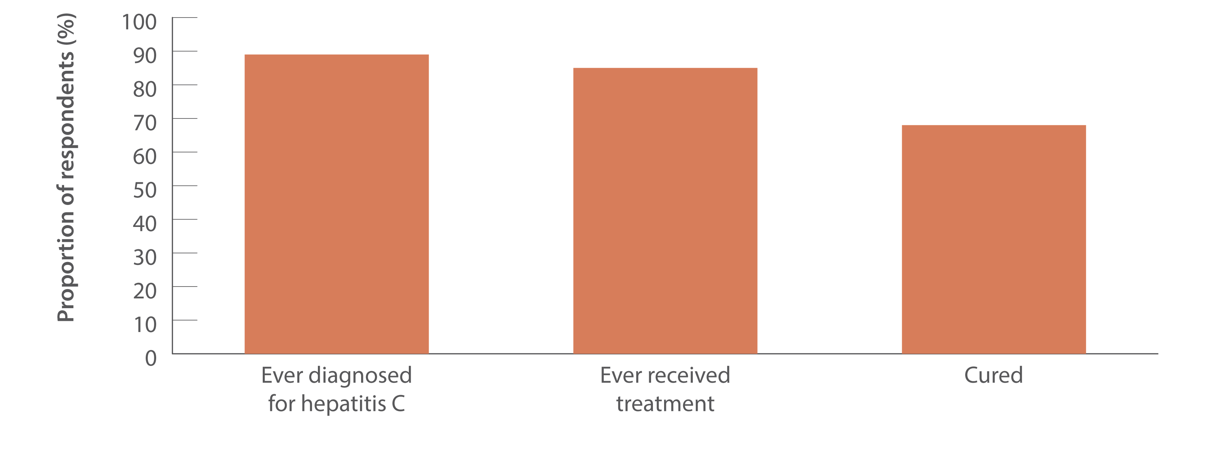
Figure 29. Proportion of people in prison ever hepatitis C treatment eligible self‑reporting treatment, Australian Hepatitis and Risk Survey in Prisons, April 2022–June 2023
Uptake of treatment
Source: Adapted from Bah et al., Int J Drug Policy 2024,⁽²³⁾ and Bah et al. The Lancet Reg Health Western Pac 2024.⁽²⁴⁾
Notes:
Notes: Denominator population is people ever eligible for treatment, defined as those with detectable HCV RNA (study‑conducted test), regardless of the history of treatment or those HCV antibody positive (study‑conducted test) who had a self‑reported history of treatment. Participants diagnosed for hepatitis C were defined as those ever treatment eligible who had ever been told by a health professional that they had chronic hepatitis C. Hepatitis C cure was defined by a positive HCV antibody and undetected HCV RNA among those who had received treatment (study‑conducted test). Those without ‘cure’ (i.e., study‑conducted HCV RNA positive) includes people who have not responded to treatment or those who may have achieved a sustained virological response (SVR) but were reinfected.

Slide 43
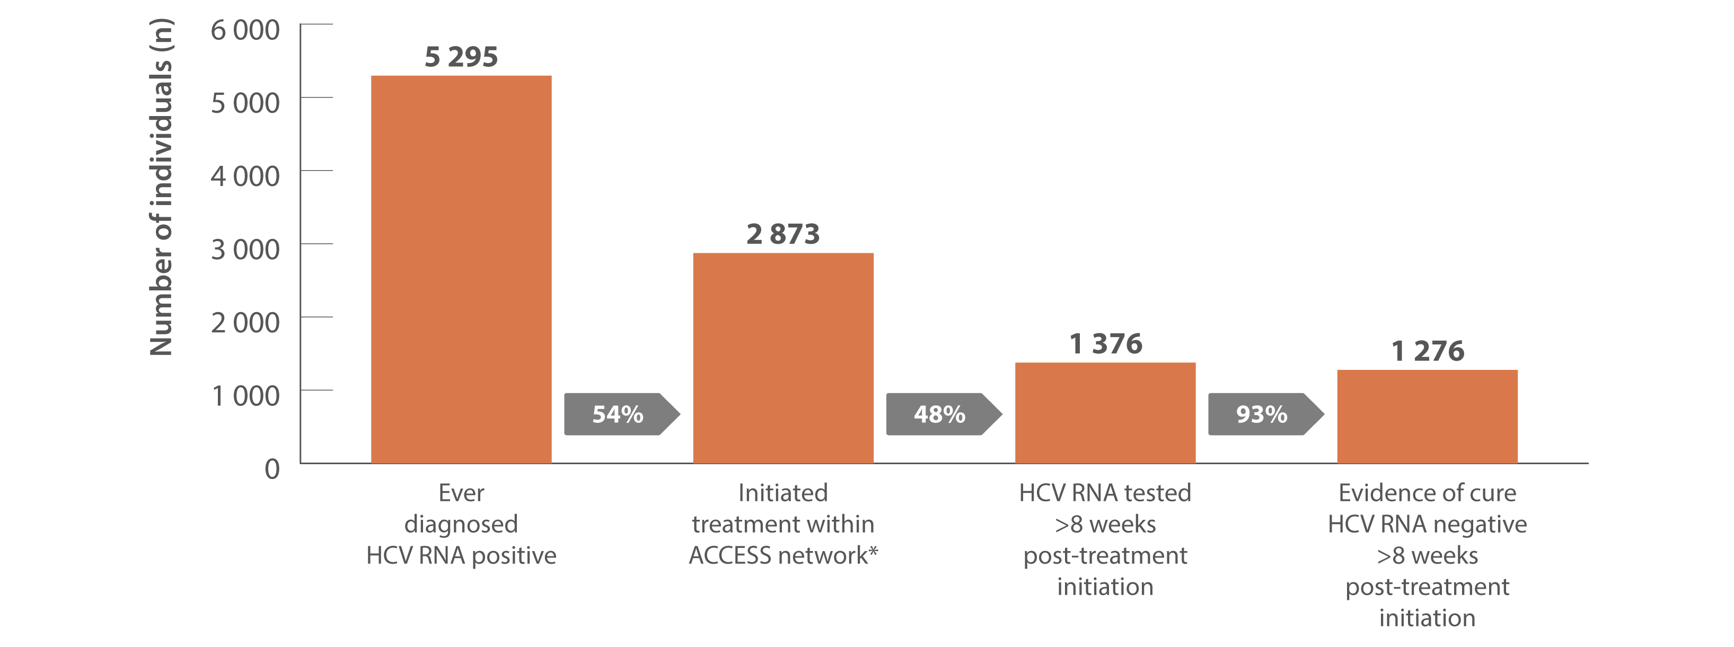
Figure 30. Hepatitis C treatment cascade at ACCESS primary care clinics: number of individuals hepatitis C diagnosed, number and proportion of individuals who initiated treatment, and tested for HCV RNA post‑treatment initiation, 2016–2023
Uptake of treatment
Source: ACCESS.⁽¹¹⁾ Updated from Traeger et al., PLOS One 2020.⁽³⁵⁾
Notes:
Notes: Cascade includes individuals with evidence of ever being diagnosed HCV RNA positive, i.e., a positive HCV RNA test result recorded in ACCESS since 2009. The cascade reflects the status of individuals on 31 December 2023 and is restricted to individuals who had a clinical consultation between 2016 and 2023. Includes individuals attending ACCESS primary care clinics (same primary care clinics as other ACCESS sections in report). *Treatment initiation was indicated by the presence of an electronic medical record of a prescription of DAA therapy recorded at an ACCESS clinic. Individuals were assumed to have progressed through preceding cascade stages if evidence of reaching a subsequent stage was present.

Slide 44
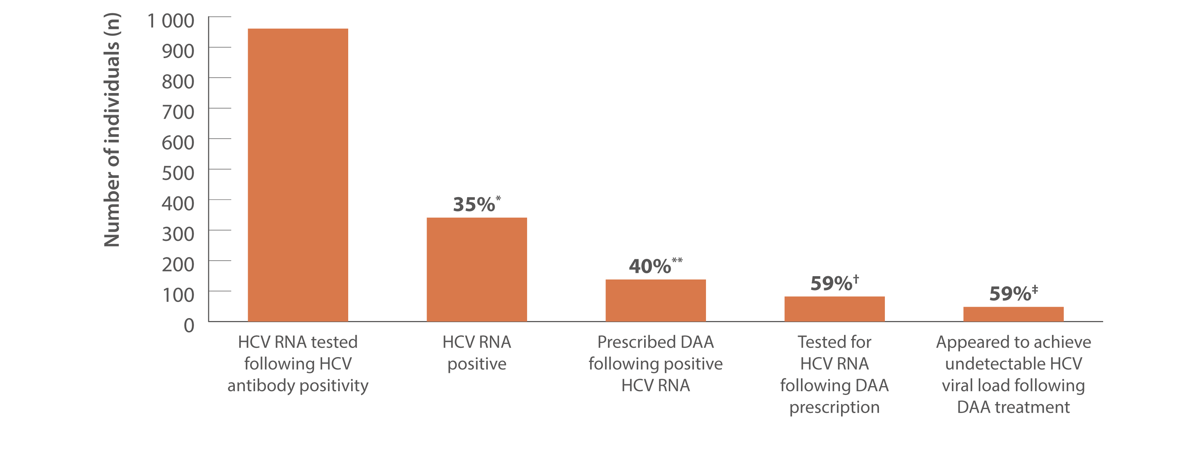
Figure 31. Hepatitis C treatment cascade: number and proportion of individuals attending ACCHS tested for HCV RNA and prescribed DAAs, and among those treated, the number and proportion who appeared to achieve an undetectable HCV viral load, ATLAS network, aggregated for years 2016–2023
Uptake of treatment
Source: ATLAS Indigenous Primary Care Surveillance and Research Network, 2016–2023.⁽¹⁸⁾
Notes:
Notes: Individuals defined as people aged 15 years or older, who visited a doctor, nurse, or Aboriginal health practitioner (‘medical consultations’) 2016–2023. ‘Undetectable viral load’ defined as testing negative for HCV RNA or HCV viral load following DAA treatment. A total of 178 816 individuals aged 15 years or older attended medical appointments between 2016 and 2023. *Of individuals who were HCV RNA tested following an HCV antibody positive test, 35% (341/961) tested positive. **Of those who tested HCV RNA positive, 40% (138/341) were then prescribed DAA treatment. †Of those prescribed DAAs, 59% (82/138) had an HCV RNA test following treatment, of whom ‡59% (48/82) had an undetectable viral load and 41% (34/82) were either positive or not tested (data unavailable to define these 34 further). Clinician notes/reason for HCV RNA testing was not obtained by ATLAS to further classify individuals who were HCV RNA tested but were not positive (65%; 620/961, not HCV RNA positive). If those with evidence of DAA treatment are inferred as HCV RNA positive, the proportion of positive HCV RNA testing is higher, approaching 50%.

Slide 45
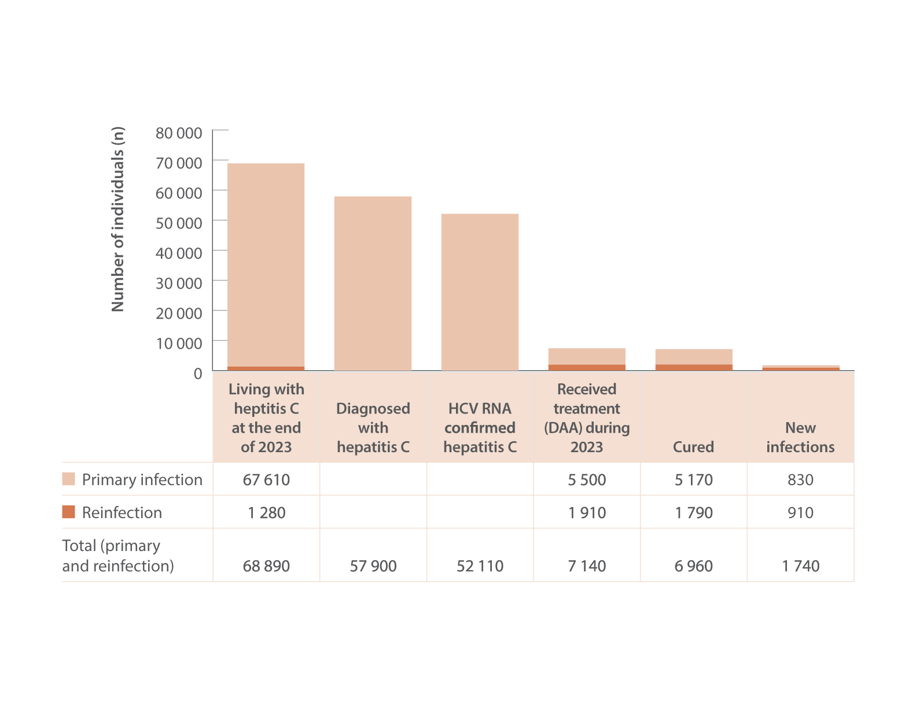
Figure 32. The 2023 hepatitis C diagnosis and care cascade, HIV, viral hepatitis and sexually transmissible infections in Australia, Annual Surveillance Report
Uptake of treatment
Source: Updated by Kirby Institute, from the HIV, viral hepatitis and sexually transmissible infections in Australia: annual surveillance report 2023.^{(2,3,4)}
Notes:
Notes: Numbers in the figure rounded for clarity. The care cascade was estimated using mathematical modelling; mathematical modelling uses available data from observational research studies and administrative datasets to derive estimates like the population prevalence of hepatitis C, accounting for uncertainties. Living with hepatitis C is the estimated number of individuals in the overall population who had detectable HCV RNA in 2023; diagnosed with hepatitis infection is the estimated number of individuals living with chronic HCV in 2023 who have been previously diagnosed (HCV antibody positive or HCV RNA); HCV RNA confirmed hepatitis C is the estimated number of individuals who are confirmed with HCV from RNA testing; received DAA treatment is the observed number of individuals who received treatment in 2023 for primary infection and reinfection; and cured is the estimated number of treated individuals who achieved undetectable HCV RNA post‑treatment in 2023.

Slide 46
Chapter Four
Hepatitis C-attributable morbidity: transplantations

Slide 47
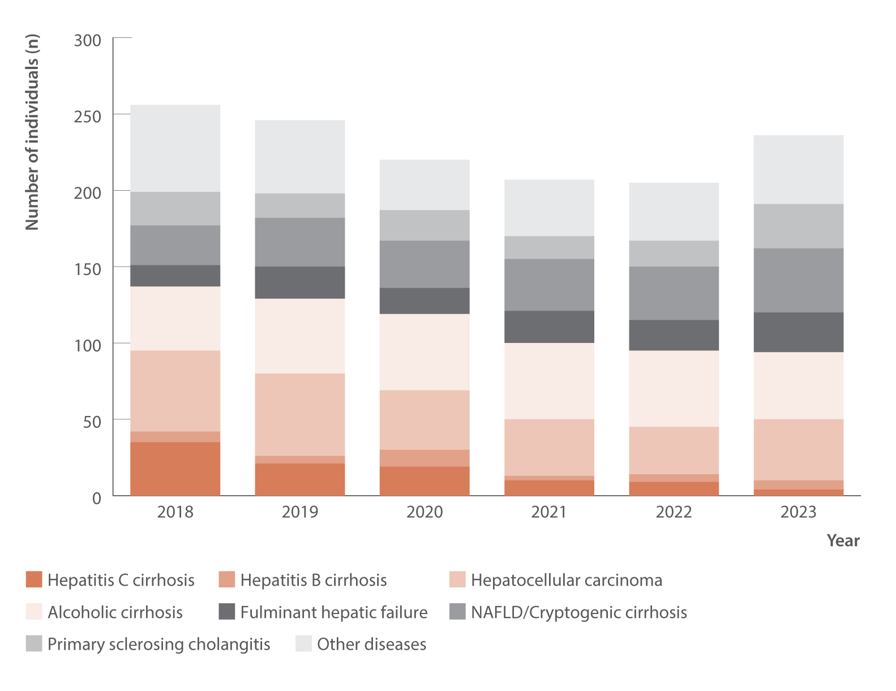
Figure 33. Number of Australian adult liver transplant recipients by primary diagnosis and year of first transplant, Australia and New Zealand Liver and Intestinal Transplant Registry, 2018–2023
Morbidity
Source: Australia and New Zealand Liver and Intestinal Transplant Registry.⁽³⁷⁾
Notes:
Notes: Australian transplant recipients only. Adults defined as 16 years or older. NAFLD: non‑alcoholic fatty liver disease.

Slide 48
Chapter Five
Stigma and discrimination experienced by people living with hepatitis C

Slide 49
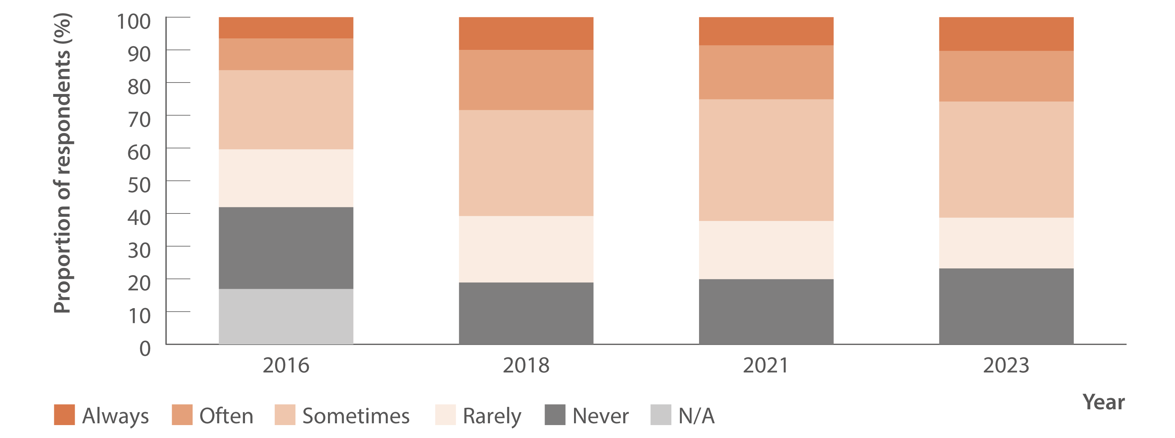
Figure 34. Reports of injecting drug use‑related stigma or discrimination in the past 12 months by people who inject drugs, 2016–2023
Stigma and discrimination
Source: Stigma Indicators Monitoring Project.⁽⁴²⁾
Notes:
Notes: “N/A” was not provided as a response option after 2016.

Slide 50
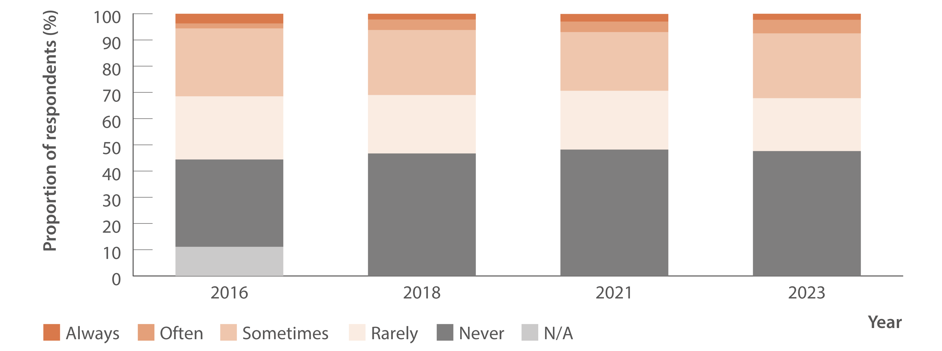
Figure 35. Reports of hepatitis C‑related stigma or discrimination in the past 12 months by people diagnosed with hepatitis C, 2016–2023
Stigma and discrimination
Source: Stigma Indicators Monitoring Project.⁽⁴³⁾
Notes:
Notes: “N/A” was not provided as a response option after 2016.

Slide 51
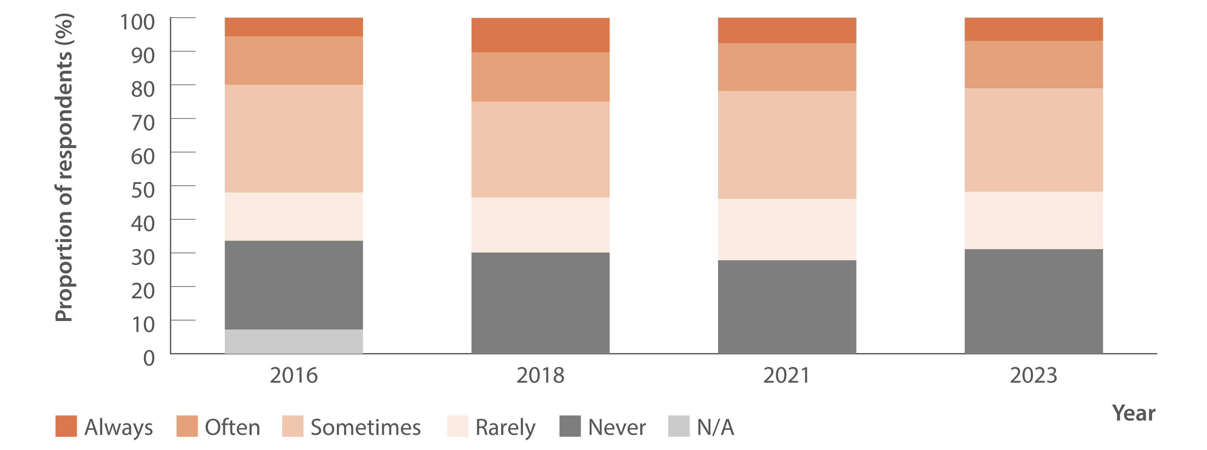
Figure 36. Reports of negative treatment from healthcare workers by people who inject drugs, 2016–2023
Stigma and discrimination
Source: Stigma Indicators Monitoring Project.⁽⁴²⁾
Notes:
Notes: “N/A” was not provided as a response option after 2016.

Slide 52
Chapter Six
Primary prevention

Slide 53
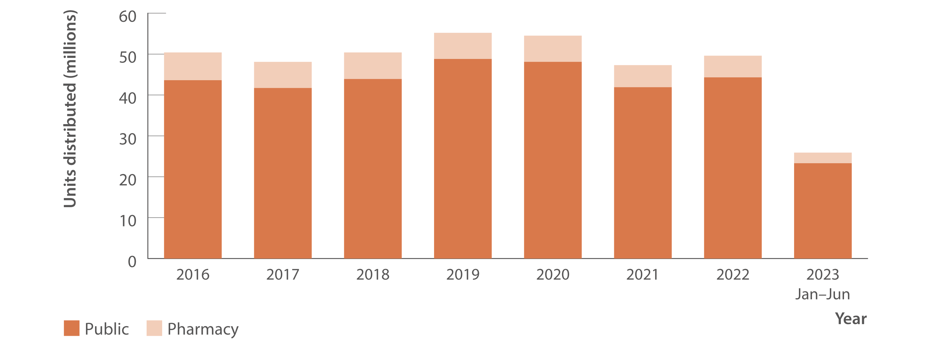
Figure 37. Number of needle and syringe units distributed by public and pharmacy sector, Needle Syringe Program National Minimum Data Collection, 2016–June 2023
Prevention
Source: Needle Syringe Program National Minimum Data Collection. National Data Report 2023.⁽⁴⁴⁾
Notes:
Notes: July–December 2023 data not available at the time of reporting.

Slide 54
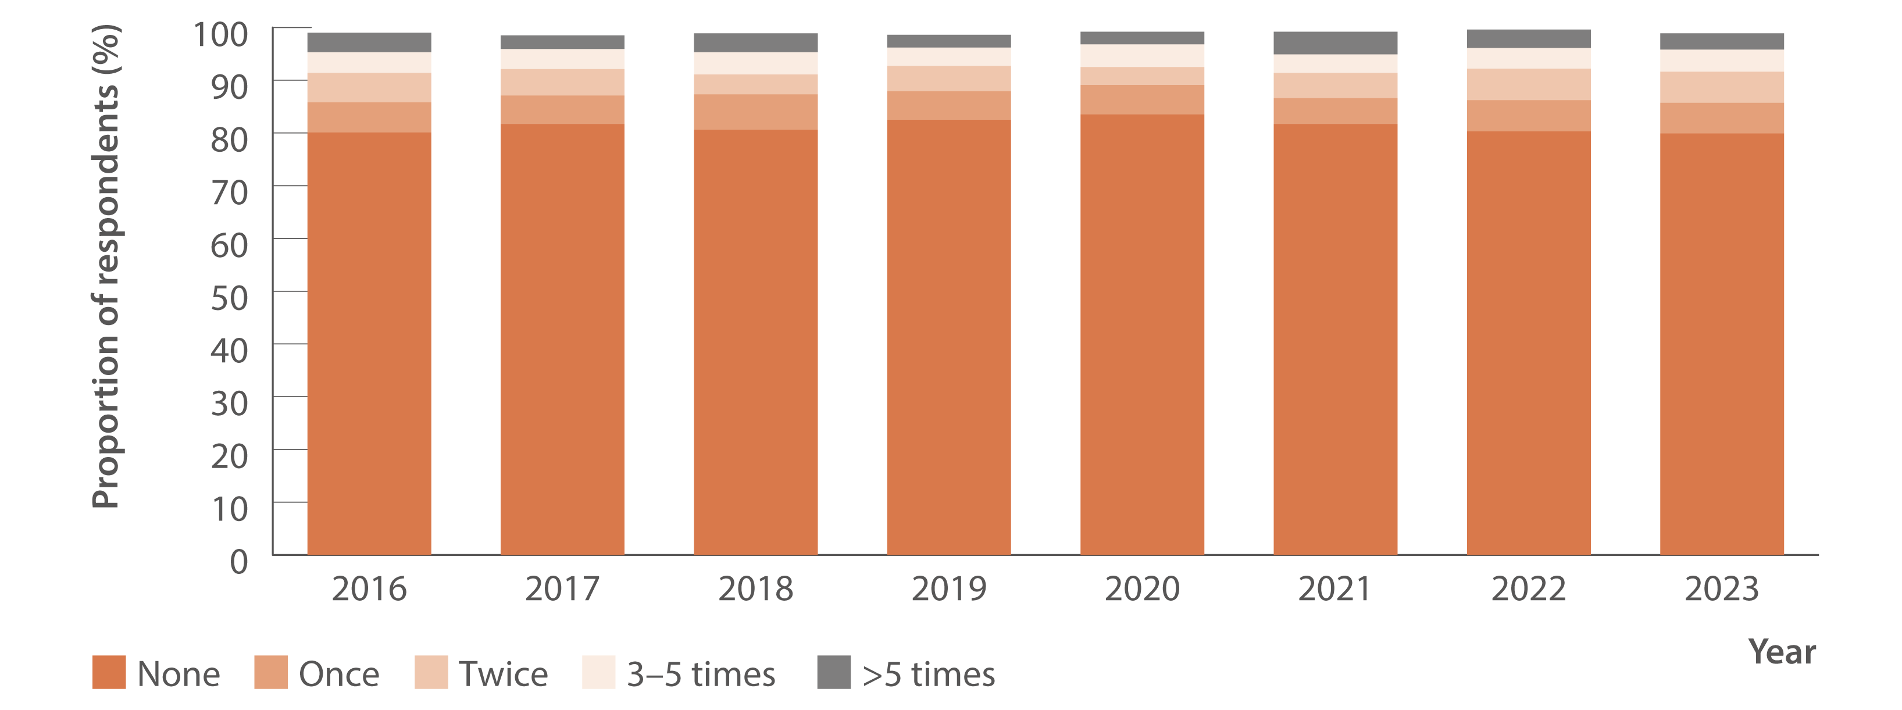
Figure 38. Proportion of Australian Needle Syringe Program Survey respondents reporting re‑use of someone else’s needles and syringes in the past month, 2016–2023
Prevention
Source: Australian Needle Syringe Program Survey. 25-year National Data Report 1995–2019.⁽²⁶⁾ Australian Needle Syringe Program Survey. National Data Report 2019–2023.⁽¹⁹⁾
Notes:
Notes: Not reported not included. Injection risk behaviour variables are presented among those who injected in the previous month, not the entire sample. For 2016 to 2023, sample size was (in order): 1 993, 2 314, 2 452, 2 333, 1 173, 1 259, 1 581, and 1 748.

Slide 55
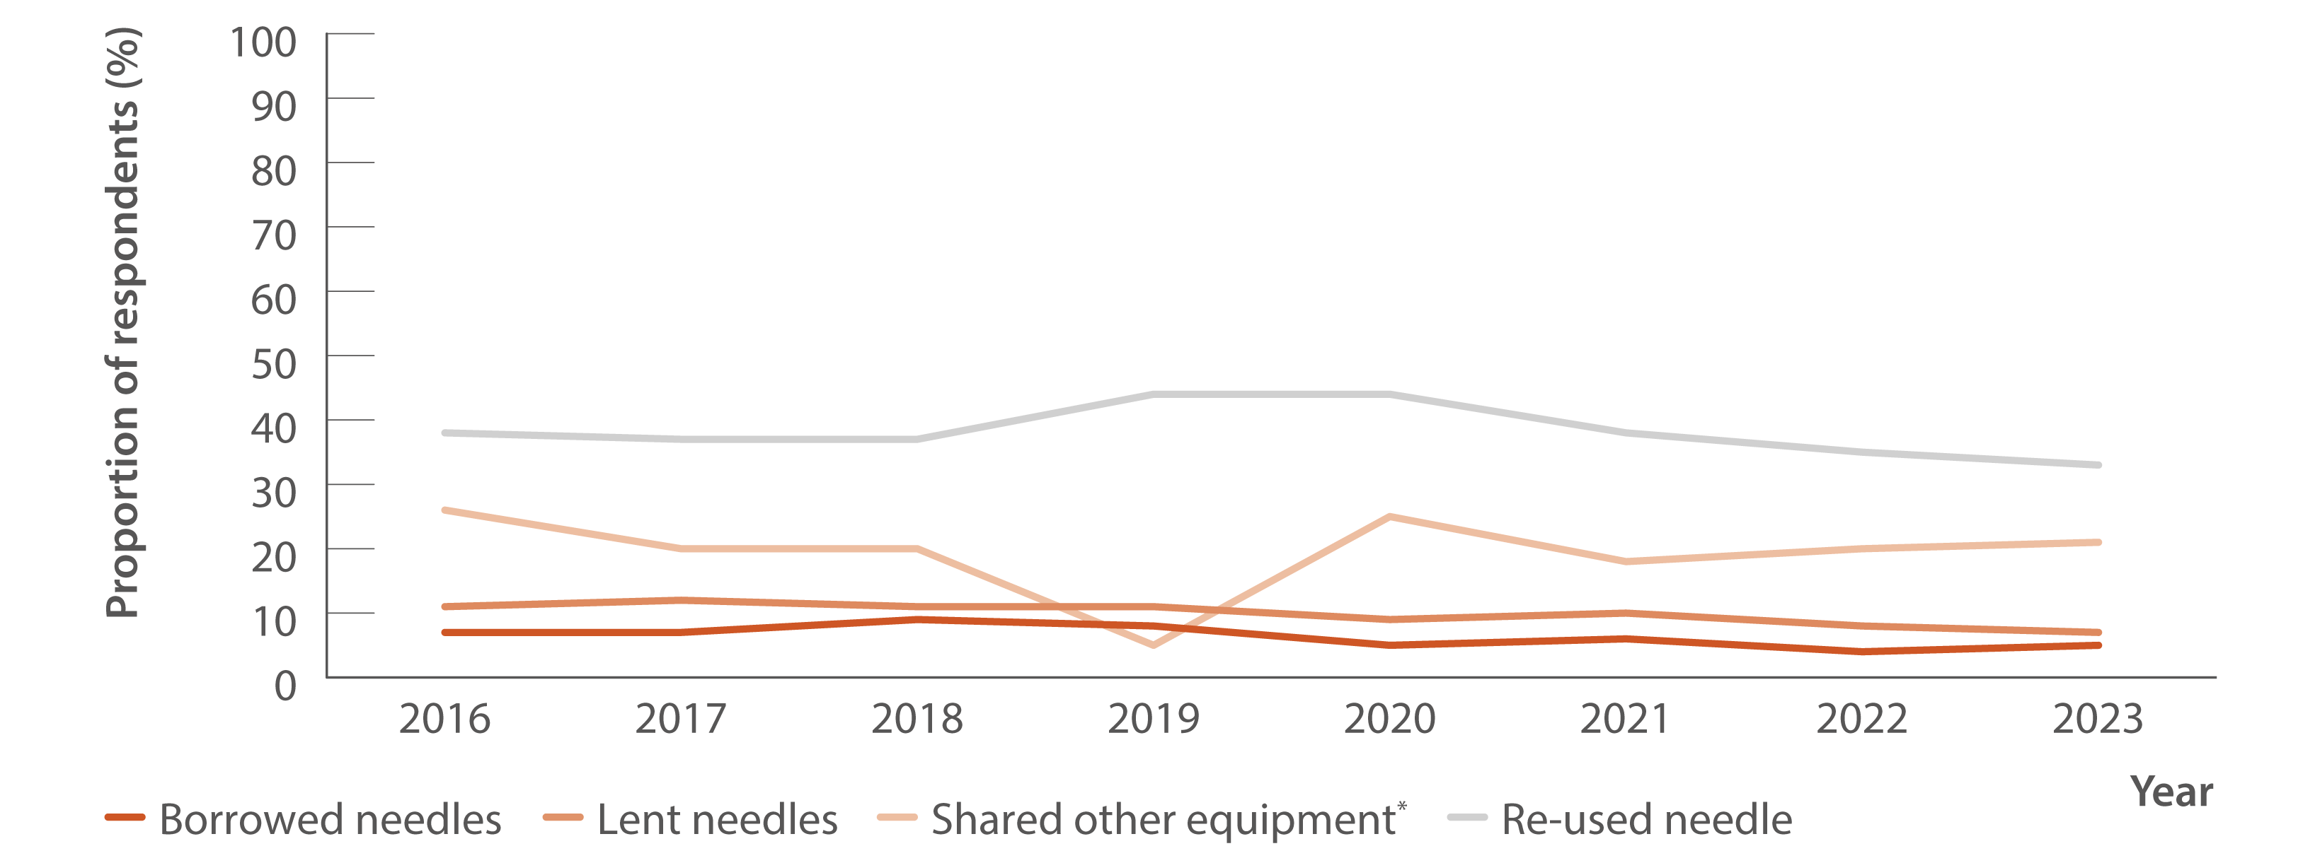
Figure 39. Proportion of respondents reporting borrowing and lending of needles, sharing of injecting equipment, and re‑use of needles in the past month, national, Illicit Drug Reporting System, 2016–2023
Prevention
Source: Australian Drug Trends 2023: key findings from the National Illicit Drug Reporting System (IDRS) Interviews.⁽⁴⁸⁾
Notes:
Notes: *Includes spoons, water, tourniquets, and filters.

Slide 56
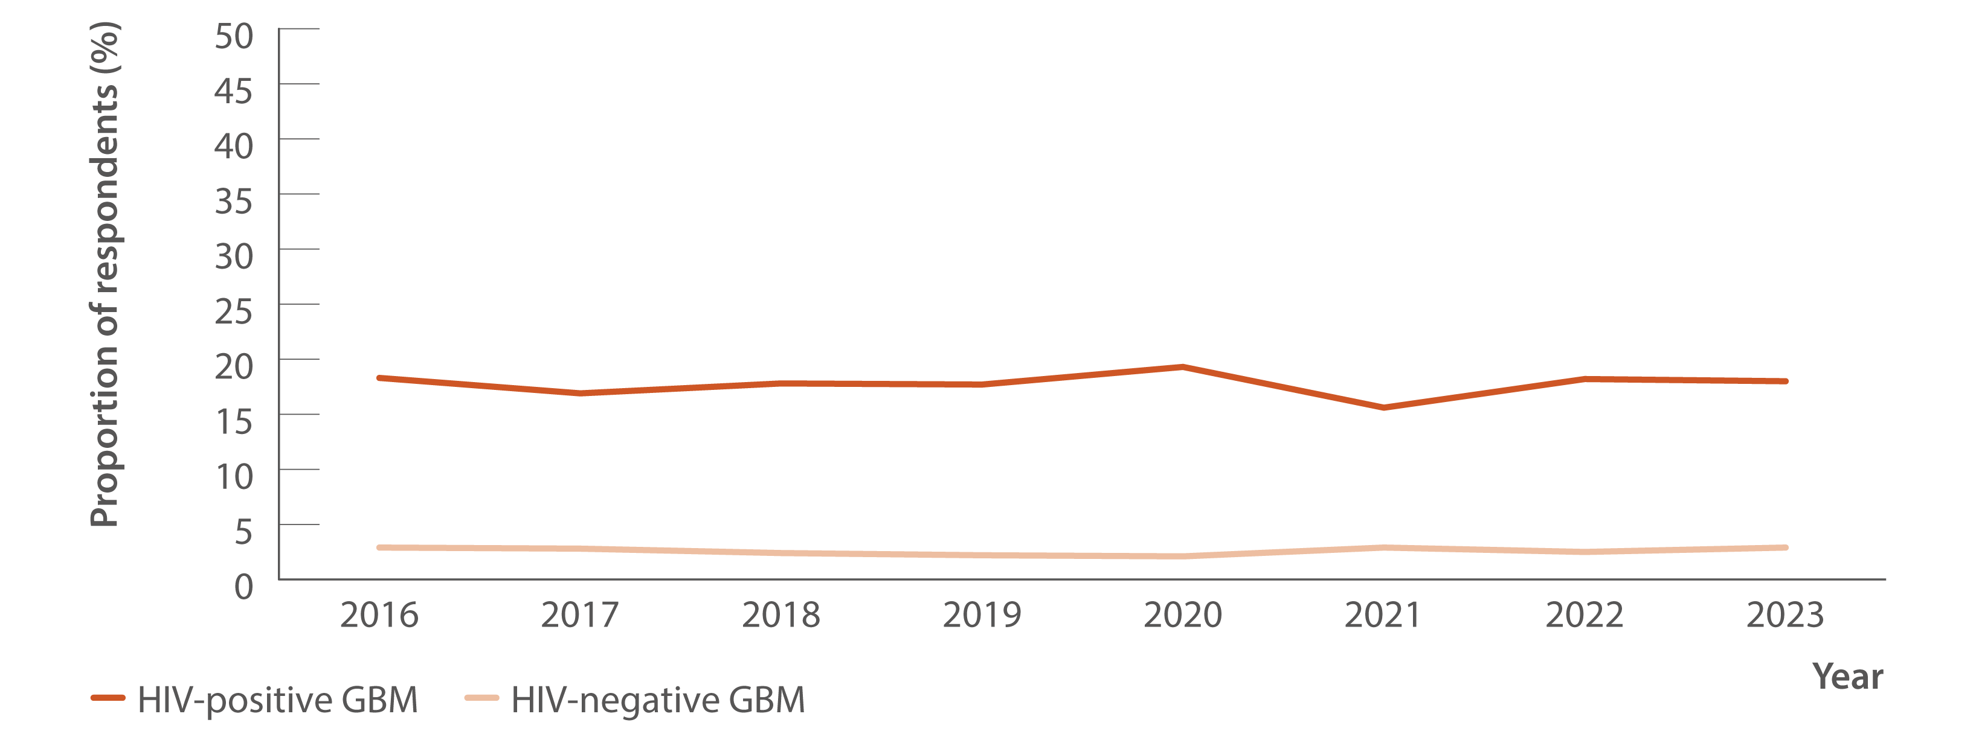
Figure 40. Proportion of GBM who reported any drug injection in the six months prior to the survey by HIV status, national, Gay Community Periodic Survey, 2016–2023
Prevention
Source: Annual Report of Trends in Behaviour 2024: HIV and STIs in Australia.^{(49,50)}
Notes:
Notes: Unadjusted data.

Slide 57
Chapter Seven
Health equity mapping

Slide 58
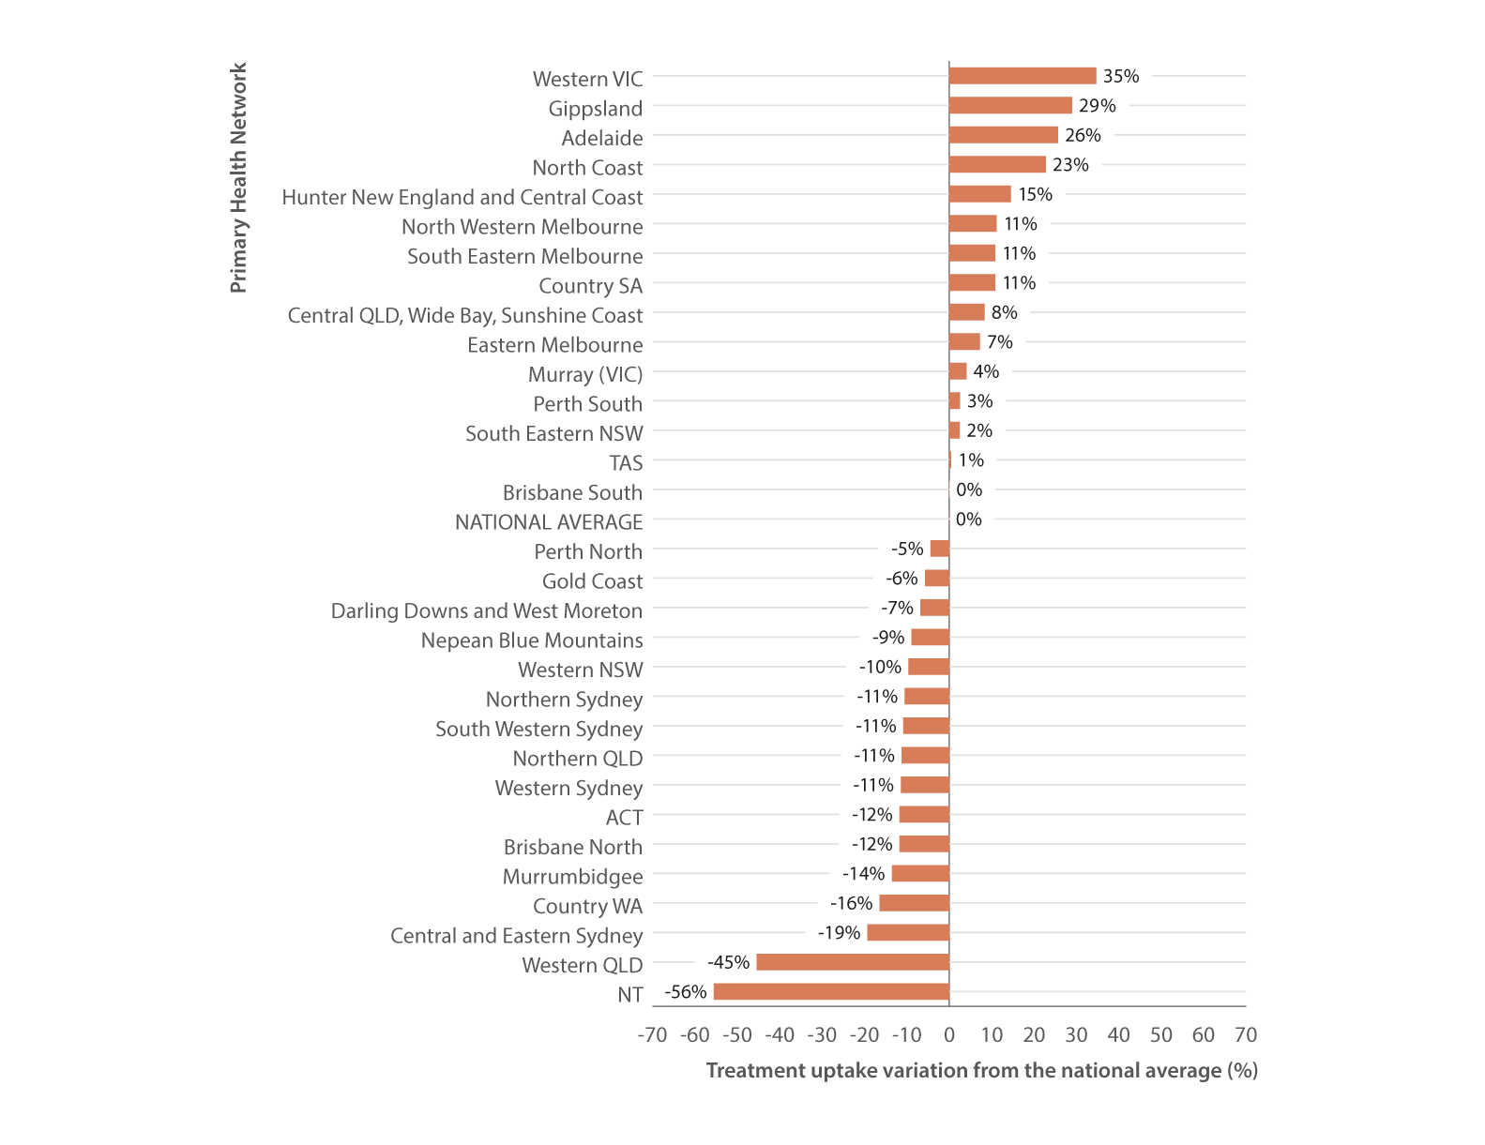
Figure 41. Hepatitis C treatment uptake variation in Australia by PHN, March 2016–October 2023
Equity
Source: The National Viral Hepatitis Mapping Project (WHO Collaborating Centre for Viral Hepatitis, The Doherty Institute).⁽⁵¹⁾
Notes:
Notes: Hepatitis C treatment uptake variation estimates based on treatment (PBS) data sourced from Medicare statistics and hepatitis C notifications according to geographic region.

Slide 59
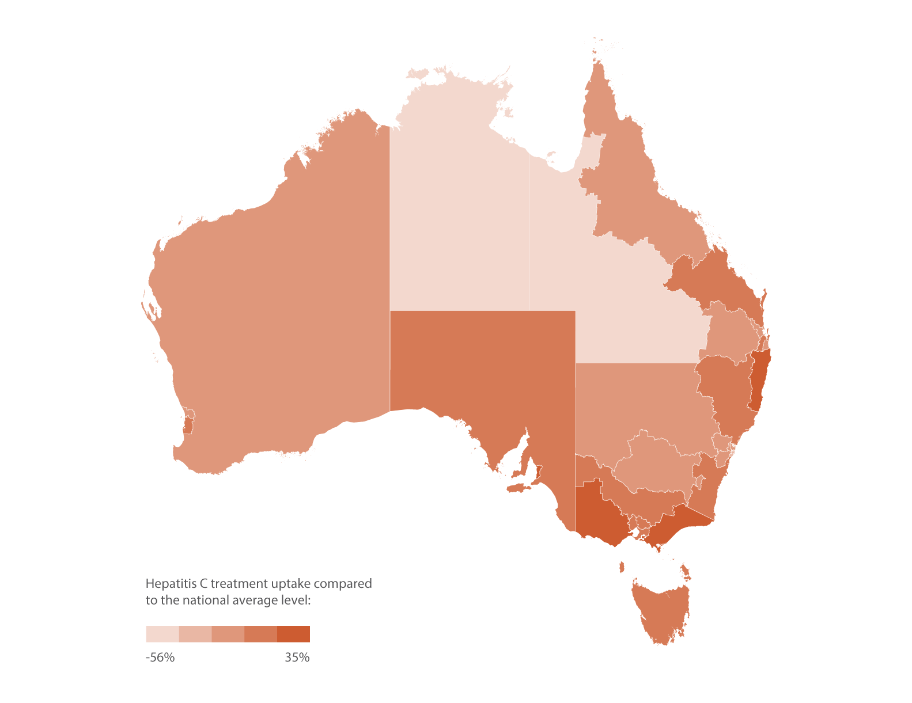
Figure 42. Geographic variation in hepatitis C treatment uptake, March 2016–October 2023
Equity
Source: The National Viral Hepatitis Mapping Project (WHO Collaborating Centre for Viral Hepatitis, The Doherty Institute).⁽⁵¹⁾
Notes:
Notes: Hepatitis C treatment uptake variation estimates based on treatment data (PBS database) sourced from Medicare statistics and hepatitis C notifications according to geographic region.

Slide 60
Chapter Eight
Modelling

Slide 61
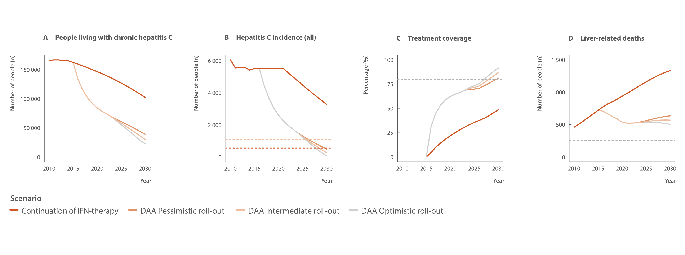
Figure 43. Annual change in people living with chronic hepatitis C, hepatitis C incidence (all), treatment coverage, and liver‑related deaths (viraemic and cured) in Australia 2030 (2010–2030) with WHO HCV elimination targets (dotted lines: Panel B: 80% and 90% reductions in incidence, Panel C: 80% eligible treated, and Panel D: 65% reduction in deaths)
Modelling elimination
Source: Updated from Kwon et al., J Viral Hepat 2019(2) and Kwon et al., PLoS One 2021.(3)
Notes:
Notes: Treatment coverage is calculated among people who have ever been diagnosed (numerator: the cumulative number of people treated since the end of 2015; denominator: the cumulative number of people cured since the end of 2015 plus the number of people who have ever been diagnosed and are still living in 2022). We assumed a pessimistic roll‑out scenario corresponding to 25% less people being treated with DAA therapy than 2023, an intermediate roll‑out scenario corresponding to the annual number treated equalling the number in 2023, and an optimistic scenario where the annual number treated increased 25% more than the 2023 level. The annual number of people treated for all three scenarios in the earlier years is as follows: 2015 (interferon plus DAA): 4 720; 2016: 32 458; 2017:21 249; 2018:15 355; and 2019: 11 433.

Slide 62
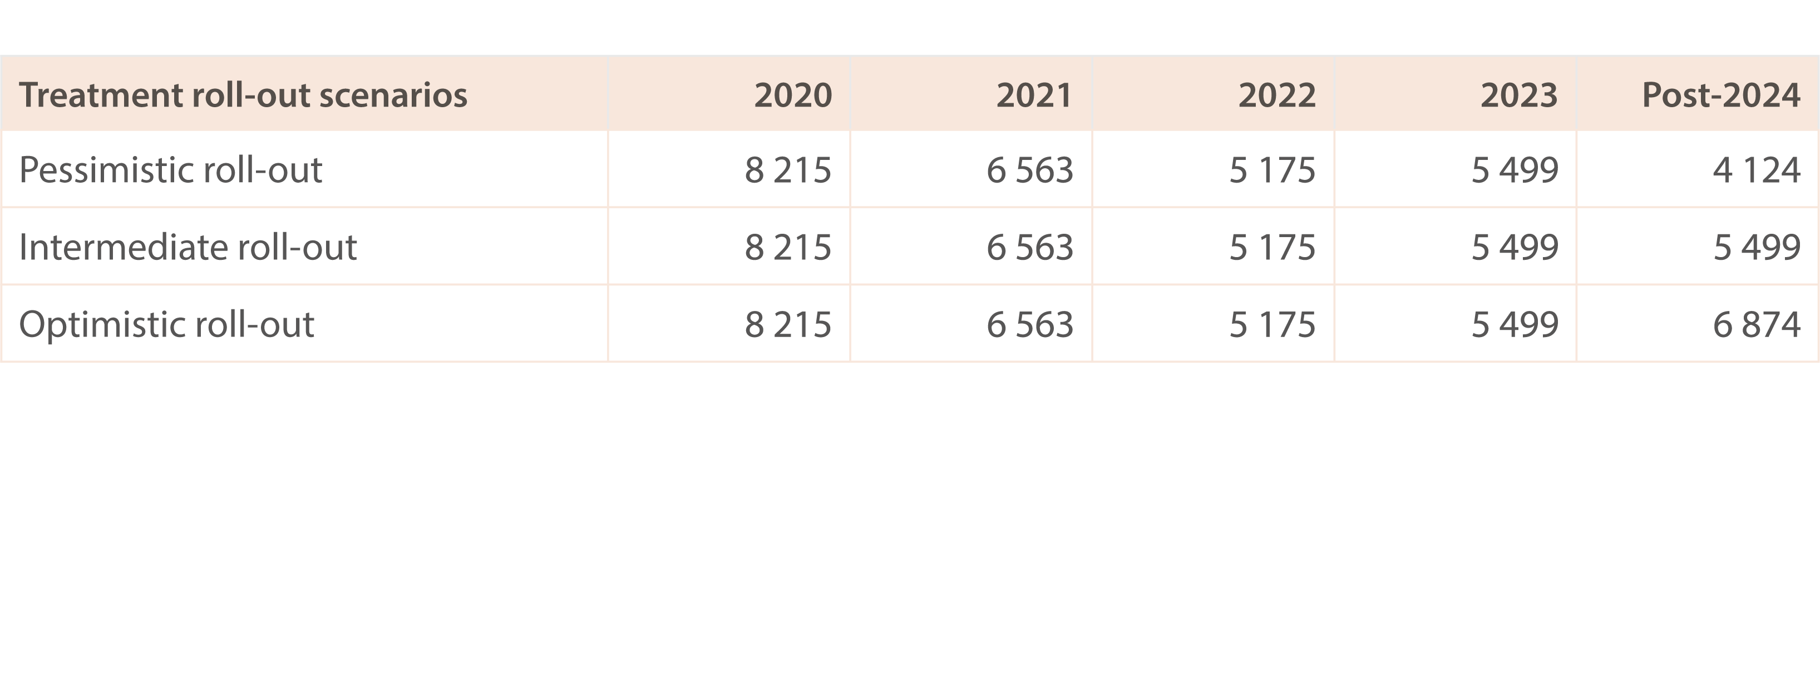
Table 2. Scenarios for the annual number of people in Australia receiving DAA
Modelling elimination
Source: Updated from Kwon et al., J Viral Hepat 2019(2) and Kwon et al., PLoS One 2021.(3)
Notes:
Notes: Treatment coverage is calculated among people who have ever been diagnosed (numerator: the cumulative number of people treated since the end of 2015; denominator: the cumulative number of people cured since the end of 2015 plus the number of people who have ever been diagnosed and are still living in 2022). We assumed a pessimistic roll‑out scenario corresponding to 25% less people being treated with DAA therapy than 2023, an intermediate roll‑out scenario corresponding to the annual number treated equalling the number in 2023, and an optimistic scenario where the annual number treated increased 25% more than the 2023 level. The annual number of people treated for all three scenarios in the earlier years is as follows: 2015 (interferon plus DAA): 4 720; 2016: 32 458; 2017:21 249; 2018:15 355; and 2019: 11 433.

Slide 63
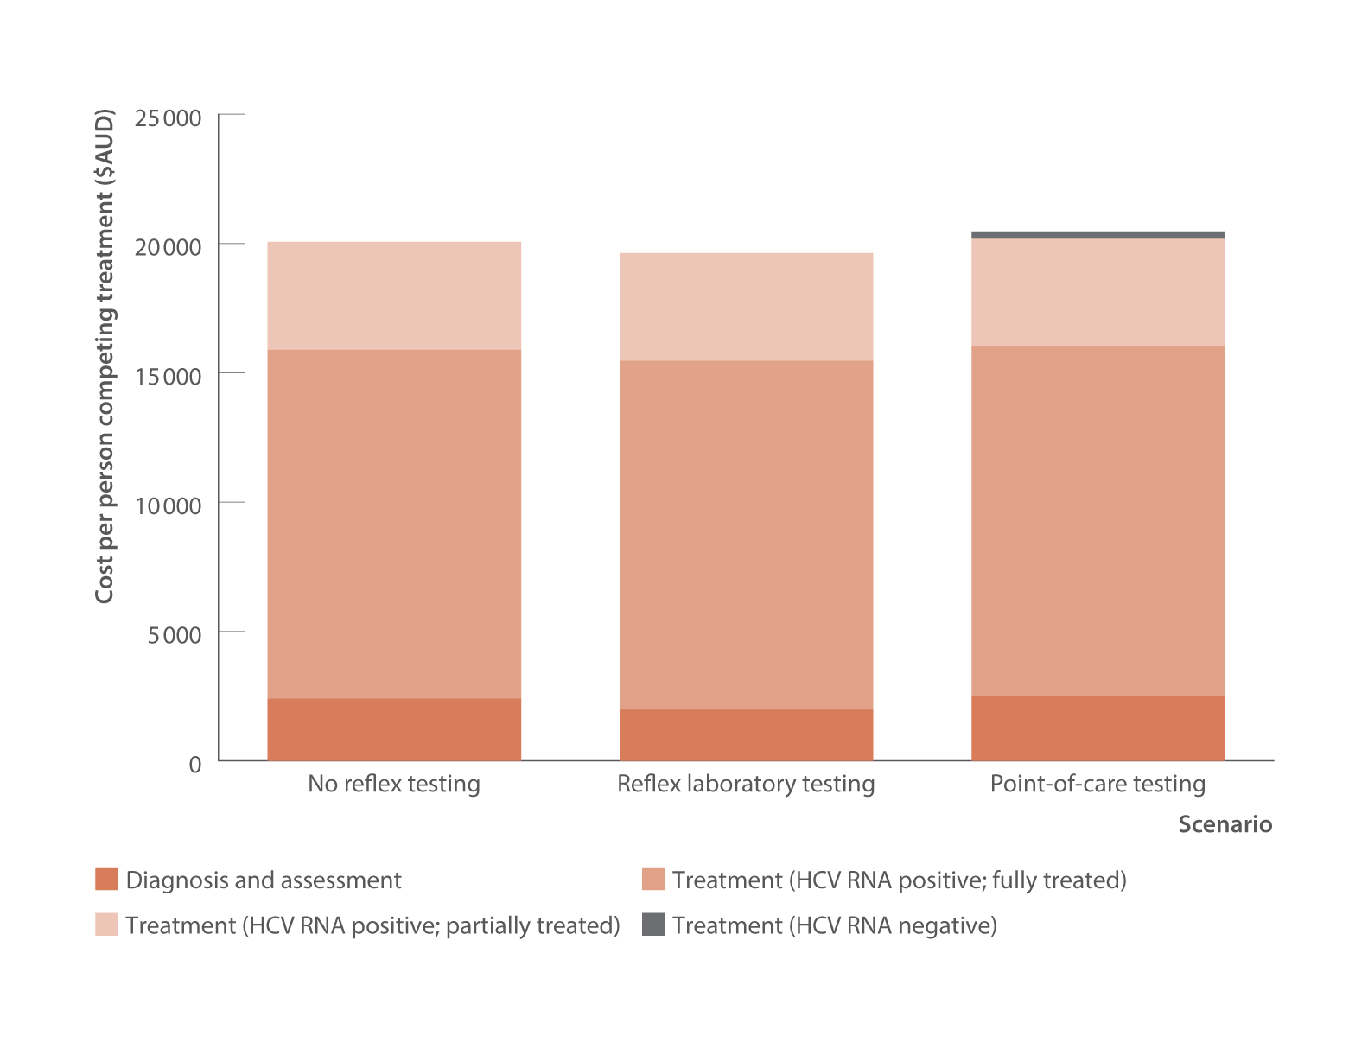
Figure 44. Estimated costs (2023 $AUD) of hepatitis C treatment initiation strategies for treatment‑naive people who inject drugs
Source: Adapted from Baille et al. 2024.(personal communication, Joseph Doyle, Burnet Institute).
Notes:
Notes: The no reflex testing scenario is laboratory HCV antibody and laboratory HCV RNA (re‑collection of venepuncture sample). The reflex laboratory scenario is laboratory HCV antibody and laboratory HCV RNA in one venepuncture collection. The point‑of‑care scenario is point‑of‑care HCV antibody test and point‑of‑care HCV RNA test. AUD: Australian Dollar.

Slide 64
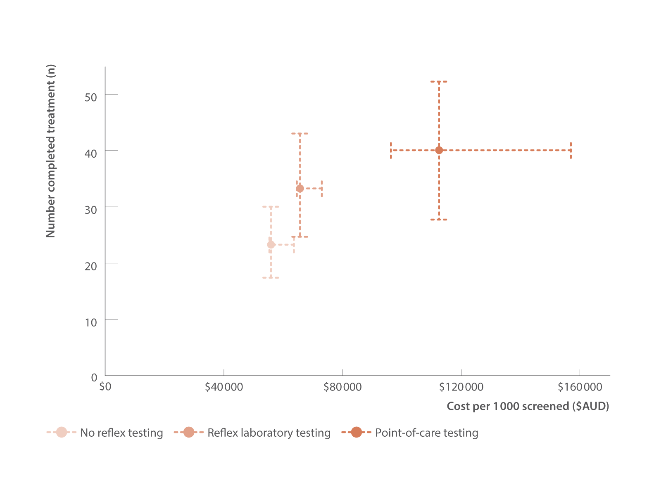
Figure 45. Estimated costs (2023 $AUD) and effectiveness of hepatitis C treatment initiation approaches for treatment‑naive people who inject drugs
Modelling elimination
Source: Adapted from Baille et al. 2024.(personal communication, Joseph Doyle, Burnet Institute).
Notes:
Notes: Costs of diagnosis, assessment, and for point‑of‑care, treatment initiation of those HCV RNA negative. Dashed lines show 95% uncertainty intervals from 1 000 probabilistic draws. AUD: Australian Dollar.

Slide 65
Reference list
1. Alavi M, Law MG, Valerio H, et al. Declining hepatitis C virus‑related liver disease burden in
the direct‑acting antiviral therapy era in New South Wales, Australia. J Hepatol. 2019;71(2):281–8.
doi: https://doi.org/10.1016/j.jhep.2019.04.014.
2. Kwon JA, Dore GJ, Grebely J, et al. Australia on track to achieve WHO HCV elimination targets
following rapid initial DAA treatment uptake: a modelling study. J Viral Hepat. 2019;26(1):83–92.
doi: https://doi.org/10.1111/jvh.13013.
3. Kwon JA, Dore GJ, Hajarizadeh B, et al. Australia could miss the WHO hepatitis C virus elimination
targets due to declining treatment uptake and ongoing burden of advanced liver disease complications.
PLoS One. 2021;16(9):e0257369. doi: https://doi.org/10.1371/journal.pone.0257369.
4. King J, McManus H, Kwon JA, Gray R, McGregor S. HIV, viral hepatitis and sexually transmissible infections in Australia: annual surveillance report 2023. Sydney, Australia: Kirby Institute, UNSW Sydney; 2023. Available at: https://www.kirby.unsw.edu.au/research/reports/asr2023 (accessed: 15th February 2024).
5. Kirby Institute. Progress towards hepatitis C elimination among Aboriginal and Torres Strait Islander people in Australia: monitoring and evaluation report, 2021. Sydney, Australia: Kirby Institute, UNSW Sydney; 2021. Available at: https://kirby.unsw.edu.au/report/progress-towards-hepatitis-c-eliminationamong- aboriginal-and-torres-strait-islander-people (accessed: 26th August 2024).
6. Dore GJ, Feld JJ. Hepatitis C virus therapeutic development: in pursuit of “perfectovir”. Clin Infect Dis.2015;60(12):1829–36. doi: https://doi.org/10.1093/cid/civ197.
7. Doyle JS, Aspinall E, Liew D, et al. Current and emerging antiviral treatments for hepatitis C infection. British J Clinical Pharmacol. 2013;75(4):931–43. doi: https://doi.org/10.1111/j.1365-2125.2012.04419.x.
8. Australian Government, Department of Health and Aged Care. Fifth National Hepatitis Strategy 2018–
2022. Canberra, Australia: Australian Government, Department of Health and Aged Care; 2018. Available at: https://www.health.gov.au/resources/publications/fifth-national-hepatitis-c-strategy 2018-2022 (accessed: 19th August 2024).
9. Australian Government, Department of Health and Aged Care. National Notifiable Disease Surveillance System. Canberra, Australia: Australian Government, Department of Health and Aged Care; 2024. Available at: https://www.health.gov.au/initiatives-and-programs/nndss (accessed: 18th September 2024).
10. O’Keefe D, Horyniak D, Dietze P. From initiating injecting drug use to regular injecting: retrospective survival analysis of injecting progression within a sample of people who inject drugs regularly. Drug Alcohol Depend. 2016;158:177–80. doi: https://doi.org/10.1016/j.drugalcdep.2015.11.022.
11. Burnet Institute, Kirby Institute, and NRL Quality. The Australian Colloboration for Coordinated
Enhanced Sentinel Surveillance of Sexually Transmissible Infections and Blood Borne Viruses (ACCESS).
Melbourne, Australia: Burnet Institute, Kirby Institute, and National Reference Laboratory; 2024.
Available at: https://accessproject.org.au/ (accessed: 15th October 2024).
12. Callander D, Moreira C, El‑Hayek C, et al. Monitoring the control of sexually transmissible infections and blood‑borne viruses: protocol for the Australian Collaboration for Coordinated Enhanced Sentinel Surveillance (ACCESS). JMIR Res Protoc. 2018;7(11):e11028. doi: https://www.researchprotocols.org/2018/11/e11028/.
13. Nguyen L, Stoové M, Boyle D, et al. Privacy‑preserving record linkage of deidentified records
within a public health surveillance system: evaluation study. J Med Internet Res. 2020;22(6):e16757.
doi: https://www.jmir.org/2020/6/e16757/.
14. Van Den Boom W, Quiroga MDM, O’Keefe D, et al. Cohort profile: the Melbourne Injecting Drug User
Cohort Study (SuperMIX). Int J Epidemiol. 2022;51(3):e123-e30. doi: https://doi.org/10.1093/ije/dyab231.

Slide 66
Reference list (cont)
15. Fisher T, Smith P, Higgs P, et al. Changes in hepatitis C prevalence and incidence associated with access to direct‑acting antivirals in a prospective cohort of people who inject drugs in Melbourne, Australia. Darwin, Australia: Australasian Viral Hepatitis Conference; 2024. Available at: https://airdrive.eventsair.com/eventsairaueprod/production-ashmpublic/d52baa613f2f4f1fad5a0fcde2a8fcbd (accessed: 30th September 2024).
16. ASHM. National Hepatitis C Testing Policy v1.4 2020. Sydney, Australia: ASHM; 2020. Available at:
http://testingportal.ashm.org.au/national-hcv-testing-policy/ (accessed: 1st June 2024).
17. Hepatitis C Virus Infection Consensus Statement Working Group. Australian recommendations for
the management of hepatitis C virus infection: a consensus statement (2022). Melbourne, Australia:
Gasteroenterological Society of Australia; 2022. Available at: https://www.hepcguidelines.org.au/
(accessed: 3rd October 2024).
18. Bradley C, Hengel B, Crawford K, et al. Establishment of a sentinel surveillance network for sexually
transmissible infections and blood borne viruses in Aboriginal primary care services across Australia: the
ATLAS project. BMC Health Services Research. 2020;20(769). doi: https://doi.org/10.1186/s12913-020-05388-y.
19. Heard S and Maher L. Australian Needle Syringe Program Survey National Data Report 2019–2023:
prevalence of HIV, HCV and injecting and sexual behaviour among NSP attendees. Sydney, Australia: Kirby Institute, UNSW Sydney; 2024. Available at: https://www.kirby.unsw.edu.au/research/reports/australian-nspsurvey-national-data-report-2019-2023 (accessed: 1st September 2024).
20. Australian Government. Medicare Australia Statistics. Canberra, Australia: Australian Government,
Services Australia; 2022. Available at: http://medicarestatistics.humanservices.gov.au/statistics/mbs_item.jsp (accessed: 5th August 2024).
21. Kirby Institute at UNSW Sydney and the Flinders University International Centre for Point‑of‑Care
Testing. Australian Hepatitis C Point‑of‑Care Testing Program. Sydney, Australia: Kirby Institute, UNSW
Sydney; 2024. Available at: https://hepcpoct.com.au/ (accessed: 15th September 2024).
22. National Prisons Hepatitis Network. Sydney, Australia: Kirby Institute, UNSW Sydney; 2024. Available at: https://www.nphn.net.au/about (accessed: 5th October 2024).
23. Bah R, Sheehan Y, Li X, et al. Challenges and facilitators in repeated bio‑behavioural surveys for
blood‑borne virus infections in Australian prisons. Int J Drug Policy. 2024:104401. doi: https://doi.
org/10.1016/j.drugpo.2024.104401.
24. Bah R, Sheehan Y, Li X, et al. Prevalence of blood borne viruses and uptake of hepatitis C testing and treatment in Australian prisons: the AusHep Study. The Lancet Reg Health Western Pac. 2024;([Online ahead of print]). doi: https://doi.org.10.1016/j.lanwpc.2024.101240.
25. Maher L, Wand H, Heard S, et al. Utilising Integrated Bio‑behavioural Surveillance (IBBS) to investigate declining hepatitis C antibody prevalence among people who inject drugs in the Australian Needle and Syringe Program Survey. Int J Drug Policy. 2024;131([Online ahead of print]):104545. doi: https://doi.org/10.1016/j.drugpo.2024.104576.
26. Heard S, Iversen J, Geedes L, et al. Australian NSP survey: prevalence of HIV, HCV and injecting and
sexual behaviour among NSP attendees, 25‑year National Data Report 1995–2019. Sydney, Australia:
Kirby Institute, UNSW Sydney; 2020. Available at: https://kirby.unsw.edu.au/report/australian-nspsurvey-25-year-national-data-report-1995-2019 (accessed: 15th April 2024).
27. Australian Bureau of Statistics. Prisoners in Australia. Canberra, Australia: Commonwealth of Australia; 2022. Available at: https://www.abs.gov.au/statistics/people/crime-and-justice/prisoners-australia/2022 (accessed: 1st September 2024).
28. Scott N, Sacks‑Davis R, Wade AJ, et al. Australia needs to increase testing to achieve hepatitis C
elimination. Med J Aust. 2020;212(8):365–70. doi: https://doi.org/10.5694/mja2.50544.

Slide 67
Reference list (cont)
29. Martin NK, Thornton A, Hickman M, et al. Can hepatitis C Virus (HCV) direct‑acting antiviral treatment as prevention reverse the HCV epidemic among men who have sex with men in the United Kingdom? Epidemiological and modeling insights. Clin Infect Dis. 2016;62(9):1072–80. doi: https://doi.org/10.1093/cid/ciw075.
30. Scott N, McBryde ES, Thompson A, et al. Treatment scale‑up to achieve global HCV incidence and
mortality elimination targets: a cost‑effectiveness model. Gut. 2017;66(8):1507–15. doi: http://dx.doi.
org/10.1136/gutjnl-2016-311504.
31. Kirby Institute. Monitoring hepatitis C treatment uptake in Australia (Issue 14). Sydney, Australia:
Kirby Institute, UNSW Sydney; July 2024. Available at: https://www.kirby.unsw.edu.au/research/reports/monitoring-hepatitis-c-treatment-uptake-australia-issue-14-july-2024 (accessed: 4th August 2024).
32. Yee J, Carson J, Hanson J, et al. Real world efficacy of antiviral therapy in chronic hepatitis C in Australia (REACH‑C). Sydney, Australia: Kirby Institute, UNSW Sydney; 2019. Available at: https://kirby.unsw.edu.au/project/reach-c (accessed: 4th October 2024).
33. Carson JM, Hajarizadeh B, Hanson J, et al. Retreatment for hepatitis C virus direct acting antiviral
therapy virological failure in primary and tertiary settings: the REACH‑C cohort. J Viral Hepat.
2022;9(24):661–76. doi: https://doi.org/10.1111/jvh.13705.
34. Carson JM, Barbieri S, Matthews GV, et al. National trends in retreatment of HCV due to reinfection or treatment failure in Australia. J Hepatol. 2022;78(2):260–70. doi: https://doi.org/10.1016/j.jhep.2022.09.011.
35. Traeger MW, Pedrana AE, van Santen DK, et al. The impact of universal access to direct‑acting antiviral therapy on the hepatitis C cascade of care among individuals attending primary and community health services. PLoS One. 2020;15(6):e0235445. doi: https://doi.org/10.1371/journal.pone.0235445.
36. Burnet Institute and Kirby Institute. Australia’s progress towards hepatitis C elimination: annual report 2023. Melbourne, Australia: Burnet Institute; 2023. Available at: https://www.burnet.edu.au/knowledgeand-media/research-reports-plus-policy-briefs/australia-s-progress-towards-hepatitis-c-eliminationannual-report-2022/ (accessed: 5th September 2024).
37. Australia and New Zealand Liver and Intestinal Transplant Registry. Melbourne, Australia: Austin Hospital; 2024. Available at: https://www.anzlitr.org/ (accessed: 24th August 2024).
38. Broady TR, Cama E, Brener L, et al. Responding to a national policy need: development of a stigma
indicator for blood‑borne viruses and sexually transmissible infections. Aust NZ J Public Health.
2018;42(6):513–5. doi: https://doi.org/10.1111/1753-6405.12809.
39. Broady TR, Brener L, Vuong T, et al. Online interventions to reduce stigma towards population
groups affected by blood borne viruses in Australia. Int J Drug Policy. 2021;96:103292. doi: https://doi.
org/10.1016/j.drugpo.2021.103292.
40. Livingston JD, Milne T, Fang ML, et al. The effectiveness of interventions for reducing stigma related to substance use disorders: a systematic review. Addiction. 2012;107(1):39‑50. doi: https://doi.org/10.1111/j.1360-0443.2011.03601.x.
41. Gronholm PC, Henderson C, Deb T, et al. Interventions to reduce discrimination and stigma: the state of the art. Soc Psychiatry Psychiatr Epidemiol. 2017;52(3):249‑58. doi: https://doi.org/10.1007/s00127-017-1341-9.
42. Broady T, Brener L, Cama E, et al. Stigma snapshot: people who inject drugs 2023. Sydney, Australia: Centre for Social Research in Health, UNSW Sydney; 2023. Available at: https://doi.org/10.26190/cpyt-yz29 (accessed: 15th September 2024).
43. Broady T, Brener L, Cama E, Treloar C. Stigma snapshot: people living with hepatitis C 2023. Sydney, Australia: Centre for Social Research in Health, UNSW Sydney; 2023. Available at: https://doi.org/10.26190/svt5-dk21 (accessed: 15th September 2024).

Slide 68
Reference list (cont)
44. Heard S, Zolala F, Kwon JA, et al. Needle Syringe Program National Minimum Data Collection: National Data Report 2023. Sydney, Australia: Kirby Institute, UNSW Sydney; 2023. Available at: https://www.kirby.unsw.edu.au/research/projects/nsp-nmdc#:~:text=The%20NSP%20National%20Minimum%20Data%20Collection (accessed: 25th September 2024).
45. Merone L, Ashton S, Harris A, et al. A complex increase in hepatitis C virus in a correctional facility:
bumps in the road. Aust N Z J Public Health. 2022;46(3):377–81. doi: https://doi.org/10.1111/1753-
6405.13238.
46. Hajarizadeh B, Grebely J, Byrne M, et al. Evaluation of hepatitis C treatment‑as‑prevention within
Australian prisons (SToP‑C): a prospective cohort study. Lancet Gastroenterol Hepatol. 2021;6(7):533–46. doi: https://doi.org/10.1016/S2468-1253(21)00077-7.
47. Cunningham EB, Hajarizadeh B, Bretana NA, et al. Ongoing incident hepatitis C virus infection
among people with a history of injecting drug use in an Australian prison setting, 2005–2014: the HITS‑p
study. J Viral Hepat. 2017;24(9):733–41. doi: https://doi.org/10.1111/jvh.12701.
48. Sutherland R, Karlsson A, Uporova J, et al. Australian Drug Trends 2024: key findings from the National Illicit Drug Reporting System (IDRS) Interviews. Sydney, Australia: National Drug and Alcohol Research Centre, UNSW Sydney; 2024. Available at: https://www.unsw.edu.au/research/ndarc/resources/australiandrug-trends-2024-key-findings-from-the-idrs (accessed: 8th October 2024).
49. Broady T, Rance J, Cama E, et al. Annual Report of Trends in Behaviour 2024: HIV and STIs in Australia. Sydney, Australia: Centre for Social Research in Health, UNSW Sydney; 2024. Available at: https://www.arts.unsw.edu.au/centre-social-research-health/our-projects/annual-report-trends-behaviour (accessed: 3rd October 2024).
50. Holt M, Lea T, Mao L, et al. Adapting behavioural surveillance to antiretroviral‑based HIV prevention: reviewing and anticipating trends in the Australian Gay Community Periodic Surveys. Sex Health. 2017;14(1):72–9. doi: https://doi.org/10.1071/SH16072.
51. MacLachlan J, Purcell I, Romero N, et al. Viral Hepatitis Mapping Project: National Report 2021–2023.Sydney, Australia: ASHM; 2024. Available at: https://ashm.org.au/programs/Viral-Hepatitis-Mapping-Project/ (accessed: 7th October 2024).
52. The Royal College of Pathologists of Australasia. Position statement: reflex Hepatitis C PCR tests on
antibody indeterminate and HCV antibody positive samples as a pathologist determinable test. Sydney,
Australia: The Royal College of Pathologists of Australasia; 2022. Available at: https://www.rcpa.edu.au/getattachment/074a10bb-1fb5-4f45-af46-0f3e14912631/HCV-Reflex-Testing.aspx (accessed: 31st August 2024).
53. Yousafzai MT, Alavi M, Valerio H, et al. Hepatitis C care cascade before and during the direct‑acting
antiviral eras in New South Wales, Australia: a population‑based linkage study. J Viral Hepat.
2023;30(3):250‑61. doi: https://doi.org/10.1111/jvh.13791.
54. Iversen J, Dore GJ, Starr M, et al. Estimating the Consensus hepatitis C Cascade of Care among people who inject drugs in Australia: pre and post availability of direct acting antiviral therapy. Int J Drug Policy. 2020;83:102837. doi: https://doi.org/10.1016/j.drugpo.2020.102837.
55. Howell J, Traeger MW, Williams B, et al. The impact of point‑of‑care hepatitis C testing in needle and syringe exchange programs on linkage to care and treatment uptake among people who inject drugs: an Australian pilot study. J Viral Hepat. 2022;29(5):375-84. doi: https://doi.org/10.1111/jvh.13664.

Slide 69
Reference list (cont)
56. Khuroo MS, Khuroo NS, Khuroo MS. Diagnostic accuracy of point‑of‑care tests for hepatitis C virus
infection: a systematic review and meta‑analysis. PLoS One. 2015;10(3):e0121450. doi: https://doi.
org/10.1371/journal.pone.0121450. 57. Catlett B, Hajarizadeh B, Cunningham E, et al. Diagnostic accuracy of assays using point‑of‑care testing or dried blood spot samples for the determination of hepatitis C virus RNA: a systematic review. J Infect Dis. 2022;226(6):1005‑21. doi: https://doi.org/10.1093/infdis/jiac049.
58. Mohamed Z, Scott N, Al‑Kurdi D, et al. Cost‑effectiveness of strategies to improve HCV screening,
linkage‑to‑care and treatment in remand prison settings in England. Liver Int. 2020;40(12):2950‑60.
doi: https://doi.org/10.1111/liv.14628.
59. Shih STF, Cheng Q, Carson J, et al. Optimizing point‑of‑care testing strategies for diagnosis and
treatment of hepatitis C virus infection in Australia: a model‑based cost‑effectiveness analysis. Lancet Reg Health West Pac. 2023;36:100750. doi: https://doi.org/10.1016/j.lanwpc.2023.100750.
60. Australian Government Department of Health and Aged Care. MBS Online. Canberra, Australia:
Commonwealth of Australia; 2024. Available at: https://www.mbsonline.gov.au/internet/mbsonline/
publishing.nsf/Content/Home (accessed: 18th March 2024).
61. Scott N, Palmer A, Tidhar T, et al. Assessment of the cost‑effectiveness of Australia’s risk‑sharing
agreement for direct‑acting antiviral treatments for hepatitis C: a modelling study. Lancet Reg Health West Pac. 2022;18:100316. doi: https://doi.org/10.1016/j.lanwpc.2021.100316.
62. Australian Government, Department of Health and Aged Care. Australian national notifiable
diseases and case definitions. Canberra, Australia: Australian Government, Department of Health and
Aged Care; 2021. Available at: https://www.health.gov.au/resources/collections/cdna-surveillance-casedefinitions?utm_source=health.gov.au&utm_medium=callout-auto-custom&utm_campaign=digital_
transformation (accessed: 1st October 2024).
63. Ampt FH, El Hayek C, Agius PA, et al. Anorectal swabs as a marker of male‑to‑male sexual exposure
in STI surveillance systems. Epidemiol Infect. 2017;145(12):2530–5. doi: https://doi.org/10.1017/
S095026881700098X.
64. Prince DS, Pipicella JL, Fraser M, et al. Screening Emergency Admissions at Risk of Chronic Hepatitis C (SEARCH) to diagnose or ‘re‑diagnose’ infections is effective in Australia. J Viral Hepat. 2021;28(1):121–8. doi: https://doi.org/10.1111/jvh.13393.
65. Valerio H, Alavi M, Conway A, et al. Declining prevalence of current HCV infection and increased
treatment uptake among people who inject drugs: the ETHOS Engage study. Int J Drug Policy.
2022;105:103706. doi: https://doi.org/10.1016/j.drugpo.2022.103706.
66. Kirby Institute. Hepatitis C elimination in NSW: monitoring and evaluation report, 2024. Sydney,
Australia: Kirby Institute UNSW, Sydney; 2024. Available at: https://www.kirby.unsw.edu.au/research/
reports/hepatitis-c-elimination-nsw-monitoring-and-evaluation-report-2024#:~:text=This%20report%20
evaluates%20progress%20towards (accessed: 4th October 2024).
67. Read P, Tang BZH, Silins E, et al. Hepatitis C reinfection and risk factors among clients of a
low‑threshold primary healthcare service for people who inject drugs in Sydney, Australia. Viruses.
2024;16(6). doi: https://doi.org/10.3390/v16060957.

Slide 70
Acknowlegedments
Full Methods and Acknowledgements at: https://burnet.edu.au/aushepC
This report was funded by the EC Australia Partnership with support from the Burnet Institute Strategic Investment Scheme.
Consultation with community
The following organisations are thanked for their generous contributions during consultation processes:
ASHM
Australian Injecting and Illicit Drug Users League (AIVL)
Health Equity Matters
Hepatitis Australia
National Association of People with HIV Australia (NAPWHA)
NSW Community Restorative Centre (CRC)

